Slide 1
Leadership in Environmental Sustainability Certificate

Slide 2
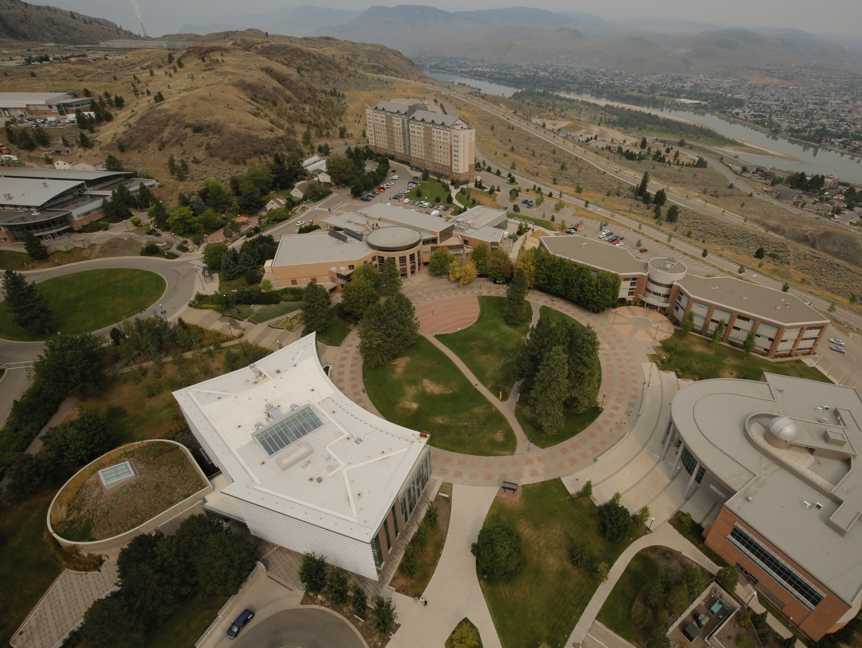
How do I gain this certificate?
1. Earn and compile points through environmentally sustainable courses, volunteer work, green jobs, attending and presenting at events and joining/leading environmentally focused groups
2. Enroll in ENSU 1000 (1 credit course). Only 1 hour of in-class time.
3. Create an e-Portfolio
4. Develop a give back piece – present a poster, YouTube video, blog, etc.
5. Write a reflective essay (1000 words)

Slide 3
Points Categories
Category | Low (1) | Medium (3) | High (5)
Course in environmental sustainability | 1 | 3 | 5
Community or TRU volunteer work | 10 hours | 20 hours | 30 hours
Employment related activity – Green jobs | 100 hours | 200 hours | 400 hours
Environmental or social organizations | Member | Active participant | Executive Member
Extra-curricular knowledge sharing | Attending events | Presenting or facilitating ONE event | Presenting or facilitating TWO events
Environmental sustainability course related work | Create or write a paper, project or poster | Present paper, project or poster within TRU community | Present paper, project or poster outside TRU

Slide 4
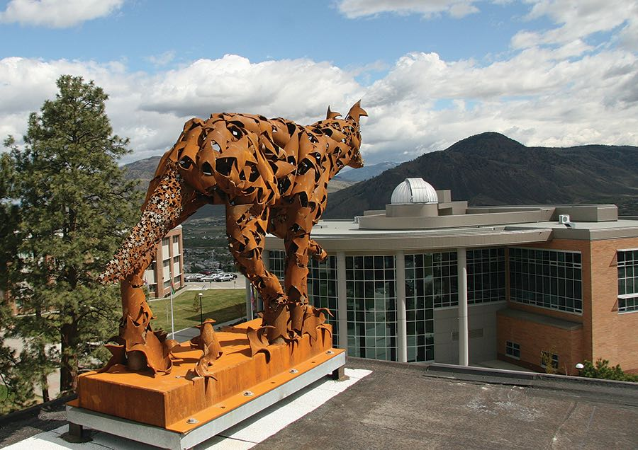
What do you get?
Students earning this credential will have it formally noted on their official TRU transcript and will have it acknowledged at the convocation ceremony.
Documented evidence of the knowledge, skills, awareness and attitudes of an environmental sustainability focused citizen.

Slide 5
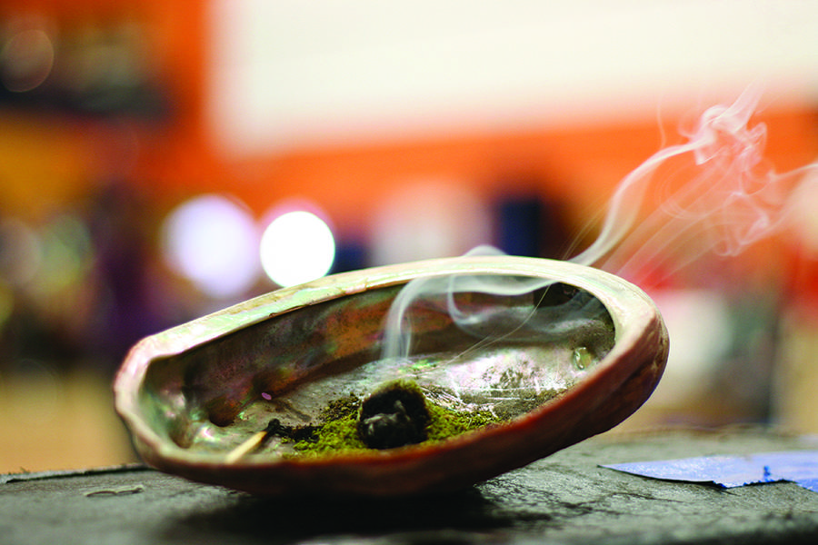
Contact
Website www.tru.ca/les
Contact: Brad Harasymchuk
Phone 250-371-5996
Email bharasymchuk@tru.ca
Office OM 1464

