Slide 1
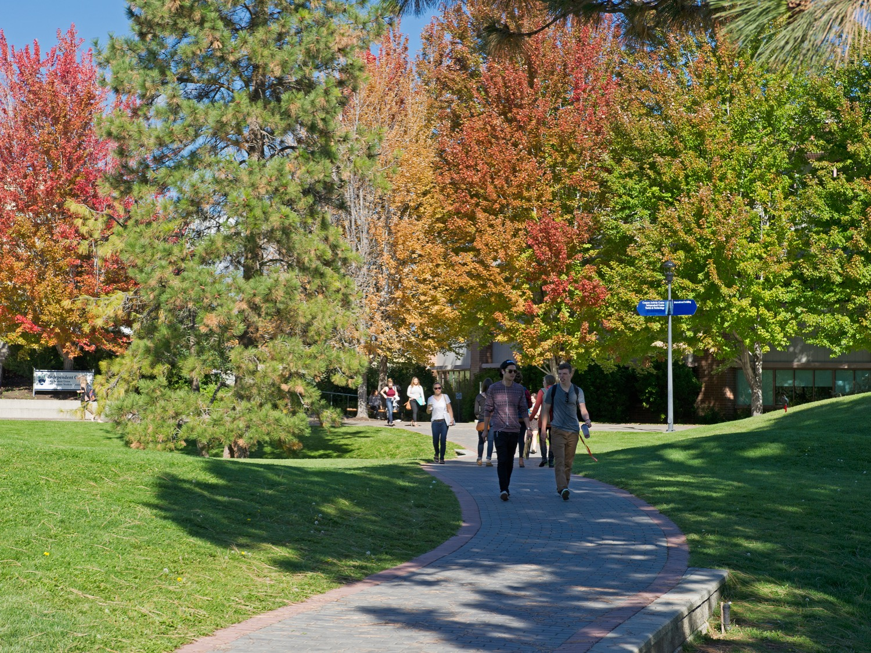
CAMPUS RESOURCES
Thompson Rivers University

Slide 3
CAMPUS RESOURCES OVERVIEW
Campus Map
Academic Supports
Wellbeing Supports
Career Supports
Other Supports
Getting Involved

Slide 4
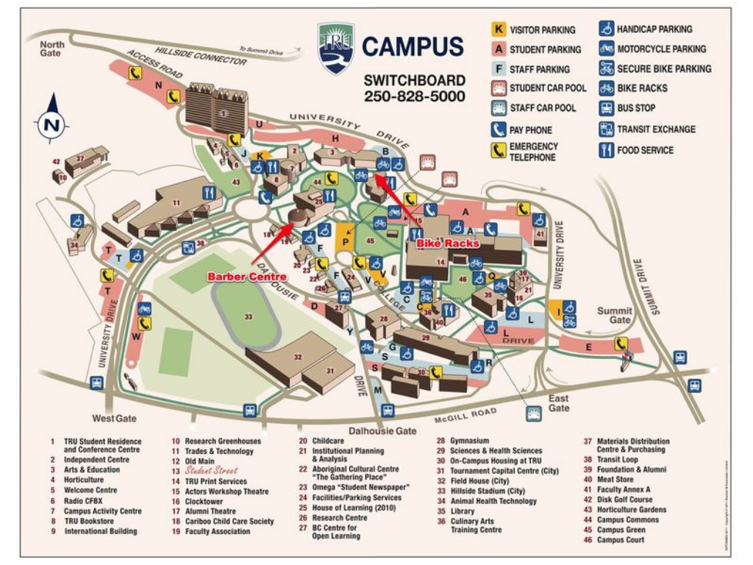

Slide 5
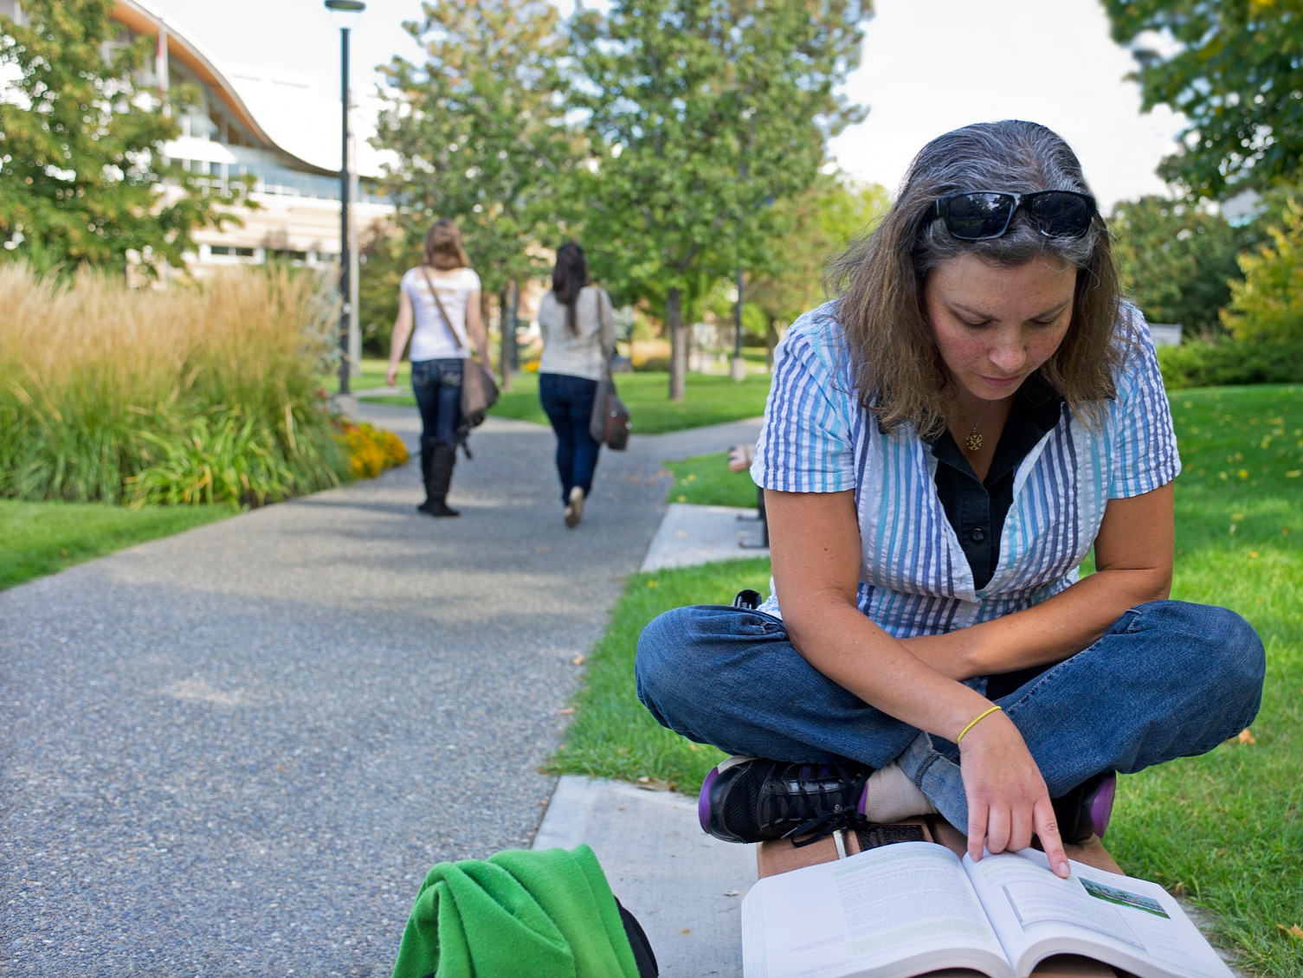
Campus Resources:
Academic Supports
OM Old Main
IB International Building
S Science Building
HOL House of Learning
AE Arts & Education Building
OL Open Learning
TRUSU Thompson Rivers University Student’s Union

Slide 6
Academic Advising
OM 1100
250-828-5075
Get answers about your program, learn about registration, course planning, and more!
Accessibility Services
OM 1631
250-828-5023
If you are living with a health condition, you can gain equal access to learning through accommodations.
Learning Strategist – Transitional Support
OM 1244
250-852-6255
Contact the learning strategist with questions or concerns about your academic progress and to learn more about campus resource supports that are available from orientation through graduation.
TRU Library
250-828-5306
tru.ca/library
Get research help, attend workshops, and access study space at one of three TRU Libraries.
Orientation and Transition
OM 1486
250-371-5942
Participate in monthly Study Skills Café workshops and meet with peer mentors for support.
Pack ACademic Edge (PACE)
OM 1244
250-852-6255
tru.ca/pace
Pack ACademic Edge provides TRU WolfPack athletes with a weekly study hall and additional support in achieving academic goals.

Slide 7
UPREP Support Centre
OM 2674
250-828-5689
University and Employment Preparation; complete a course to meet requirements for a TRU program. Get feedback on your writing skills and advice about your assignments. Book an appointment today!
Computer Science Club Support Lab
trucsclub.ca/support
The Comp-Sci support lab helps students needing some extra guidance in lower level COMP classes. View their schedule online.
Writing Centre
OM 2674
250-828-5689
Get feedback on your writing skills and advice about your assignments. Book an appointment today!
School of Business & Economics (SOBE) Help Centre
IB 2004
tru.ca/business/students
Access Accounting and Economics support from Faculty in a relaxed and informal environment. View their schedule online.
Supplemental Learning
OM 2699
250-828-5277
Master challenging intro courses with the help of free peer leaders trained in strategic learning.
Math Help Centre
HOL 304
tru.ca/mathcentre
Access free math/stats help from peer tutors and faculty by dropping into the Math Help Centre.

Slide 8
Language Learning Centre
OM 2517
250-371-5728
Get help from instructors, Teaching Assistants, and Volunteer Tutors with any area of English language study such as: writing, vocabulary, reading, listening, speaking and pronunciation.
Student Success Courses
OM 1468
250-828-5006
futurestudents@tru.ca
Five, one-credit elective student success courses that provide a strong foundation for university achievement. Offered in full or half-term formats.
Psychology Lab
AE 107
250-828-5172
sknorr@tru.ca
Enjoy a quiet area to study, work on psychology assignments or read through course materials.
Chemistry Biochemistry Club (CBC) – Chemistry Help Centre
S375
cbc@mytru.ca
The CBC is a very active undergraduate student club which is involved in many volunteer, social and educational activities.
Physics Club Help Centre
S 270
phi.six.tru@gmail.com
Visit the help centre on Tuesdays, between 12:30pm-1:30pm, to get physics help from upper level students and club leaders.
Early Alert
OM 1242
250-828-5213
earlyalert@tru.ca
tru.ca/earlyalert
If you experience academic difficulty, contact Early Alert to access resources and support services. Drop-in, email, or call to connect with your academic safety net.

Slide 9
Student Case Managers
studentaffairs@tru.ca
tru.ca/studentaffairs
Help you learn about your rights and responsibilities including academic and non-academic conduct.
International Student Advisors
IB 3rd Floor
250-828-5191
Contact your ISA for information or assistance with student life in Canada.
Graduate Study Space
250-828-5586
A 24 hour study space reserved for graduate students only. Contact Graduate Studies for access.
M.Ed/GCES Support Centre
AE 305
gsesupport@tru.ca
Book an appointment with a TA for additional help with your M.Ed/GCES coursework.
Learning Strategist – Academic Integrity
OM 1802 | 250-828-5138
Contact the Academic Integrity Learning Strategist if you have questions or concerns regarding academic integrity, the appeals process, or to inquire about the status of your case.

Slide 10
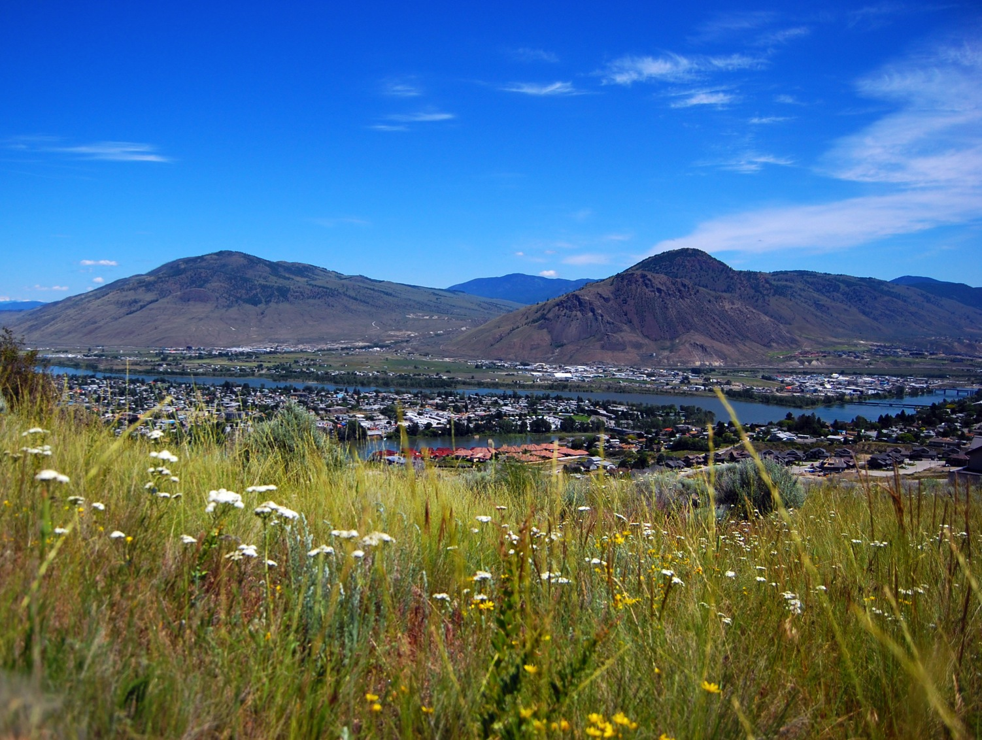
Campus Resources:
Wellbeing Supports
OM Old Main
IB International Building
S Science Building
HOL House of Learning
AE Arts & Education Building
OL Open Learning
TRUSU Thompson Rivers University Student’s Union

Slide 11
Medical Clinic
OM 1461
250-828-5126
The clinic provides a full range of medical services to students, faculty and staff. Appointments required.
Counselling
OM 1631
250-828-5023
The team of skilled counsellors can provide a range of assistance regarding academic, personal or career concerns. Drop by or call to make an appointment.
Wellness Centre
OM 1479
250-828-5010 (Chelsea)
Chelsea is the Wellness Coordinator. Make an appointment with either of them for a wellness consultation, or drop by at any time to chat with someone, enjoy free tea and snacks or just hang out.
TRU Tobacco Education Clinic
tobaccoeducation@tru.ca
2nd year respiratory therapy students can support you in quitting tobacco by offering information, assistance and physical assessments on campus free to students.
Healthy Eating Initiative Nights
TRU Residences
250-852-6333
TRU Residence on Wednesdays at 7:00pm. TRU McGill Housing on Thursdays at 7:30pm. TRU Upper College Heights on Saturdays at 8:00pm. Meals are prepared and served to students by resident advisors. Free. Drop in.
Thompson Rivers University Produce
Various locations on campus
A variety of produce can be found across campus. In the Horticulture gardens apricots, wild strawberries and rhubarb can be found in season. Apple trees are behind the trades building. There is a garden outside the South door of Old Main in which squash, peppers, fruit, herbs and garlic can be found in season. Available to students and staff for a quick snack - please do not harvest all of the produce.

Slide 12
TRU Recreation and WolfPack Games
TRU Gym Offices 303 & 308
250-828-5271
Fitness classes, intramural sports, drop-in sports and special events are offered. Fitness classes are free and on a first-come first-served basis. Drop-in sports are free, but a student card must be produced on request. Intramural sports require registration and a small fee. Special events are free or at a discounted price for TRU students. WolfPack home games on campus are always free for TRU students.
Stress Free Zone (Exam Period Only)
Main Library & House of Learning 3rd floor Library
250-828-7834
Take a break from studying and join in on some games or puzzles during exam break from 10:00am to 4:00pm. Call for more details on the next Stress Free Zone.
Cplul’kw’ten (The Gathering Place)
House 5 on Campus
250-371-5508
This inviting Indigenous centre is a safe place for Indigenous students to connect with peer mentors and Elders, access the computer lab, and participate in social and ceremonial events. A wide variety of services are offered. Soup is provided on Wednesdays at 11:30. Drop in or call.

Slide 13
Sexualized Violence Prevention and Response Manager
OM 1631
250-828-5023
Meaghan Hagerty can provide safety planning, emotional support, information about available resources among other services to individuals with any concerns regarding sexualized violence.
Multi-Faith Chaplaincy
OM 1421
250-371-5940
Connect with a chaplain or community member for spiritual or religious guidance or assistance. Drop in or call. Multi-faith prayer rooms are also offered at OM 2496 (North room) and OM2494 (South room). Book a multi-faith prayer room by calling 250-828-5014 or stop by Student Services at OM 1631.
Breastfeeding and Parenting Room
OM Adjacent to Student Street Washroom
A clean and safe environment for breastfeeding and parenting and is equipped with a comfortable chair, changing table and sink. Stop by OM 1631 to register and gain access to the room.

Slide 14
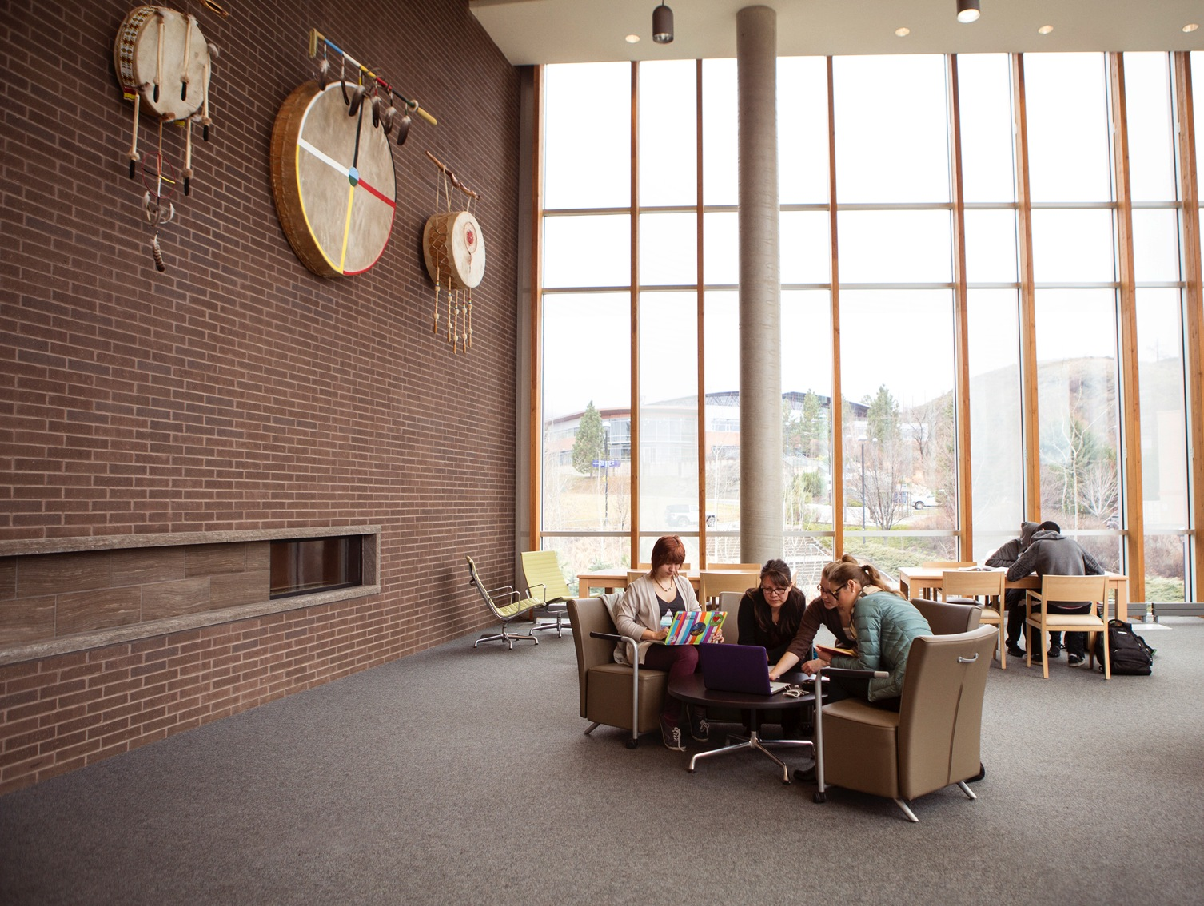
Campus Resources:
Career Supports
OM Old Main
IB International Building
S Science Building
HOL House of Learning
AE Arts & Education Building
OL Open Learning
TRUSU Thompson Rivers University Student’s Union

Slide 15
Career and Experiential Learning
Old Main 1712
250-371-5627
careereducation@tru.ca
Gain valuable experience and connections for career transition through Coop Programs, Volunteering & Internship, Career Mentoring & Planning, and Work Study Programs.
Mentorship and Leadership
OM 1486
250-371-5996
tru.ca/mentorship
tru.ca/leadership
Become a mentor or leader to your peers on campus and gain valuable training and skills for your career.
TRU Generator
HOL Basement
generator@tru.ca
Develop your skills and learn how to take an entrepreneurial approach to building your business or career.

Slide 16
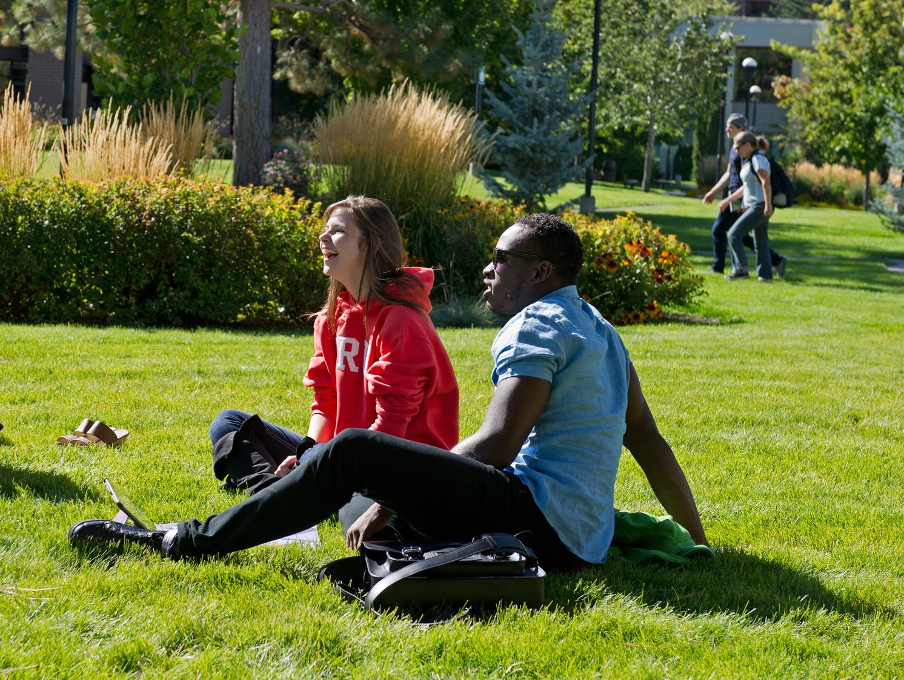
Campus Resources:
Other Supports
OM Old Main
IB International Building
S Science Building
HOL House of Learning
AE Arts & Education Building
OL Open Learning
CAC Campus Activity Centre
TRUSU Thompson Rivers University Student’s Union

Slide 17
Financial Aid & Student Awards
OM 1629
250-828-5024
A range of programs to both assist students in financing their educational and living costs and to recognize academic excellence. Financial support can be a combination of bursaries, scholarships, awards, work-study, loans and grants.
Taxation Club – Free Tax Clinic
TRUSU Boardroom – CAC lower level
trusutac@gmail.com
Get free tax filing services from accounting students, in partnership with KPMG and CIBC, whose staff assist club volunteers.
TRU Community Legal Clinic (CLC)
Located downtown at: 623 Victoria St.
778-471-8490
Access free legal assistance at this student-staffed off campus legal clinic. Call to book an appointment.
On Campus Parking Assistance – Parker Pete
1-877-771-PETE (7383)
Get free vehicle assistance for certain fixes through the Parker Pete – Motorist Assistance Program, offered to Impark customers (need fuel, locked your keys in the vehicle, dead battery, flat tire etc.). Please note if a tow is required, student is responsible for the cost.

Slide 18
Thompson Rivers University Students' Union (TRUSU)
250-828-5289
t.gilbert@trusu.ca
Advocates for students, provides services, organizes events and administers grants.
Leisure Exploration Activity Program (LEAP)
IB 1004 (beside the elevator)
TRULeap@gmail.com
Participate in or help plan year round events such as snowboarding, skiing, seasonal parties, hockey games, shopping trips, wine tours, whitewater rafting, and more.
TRU Adventure U Outdoor Club
truadventureu@gmail.com
Enjoy variety of novice, beginner, intermediate, or expert adventurer outdoor adventure activities on single and multi-day weekend trips (some weekdays).
Cariboo Child Care Society
250-828-5160
daycare@tru.ca
On campus childcare service to meet the needs of students, faculty/staff and off campus families.

Slide 19
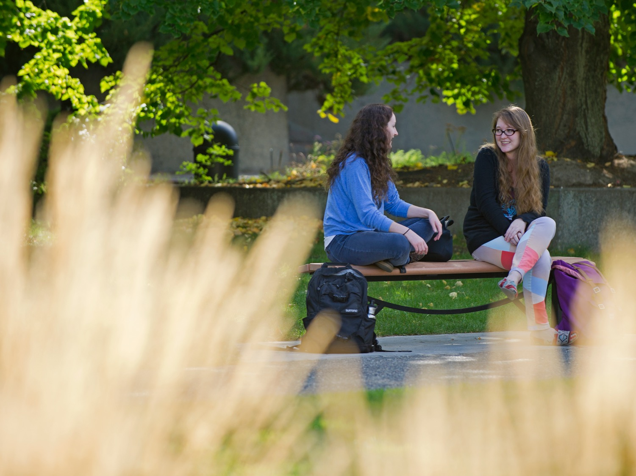
Campus Resources:
Getting Involved

Slide 20
TRU Events Calendar
https://inside.tru.ca/events
Find out what’s taking place on and off campus!
Aug. 28th | Mature & Transfer Student Orientation 6:00pm – 7:30pm | Student Street in Old Main
Sep. 3rd | TRU Orientation 9:00am – 3:00pm | Various locations on Campus
Sep. 3rd | Graduate Orientation 10:30am – 11:30am | Graduate Commons (east side of the Main Library)
Sep. 6th | TRUSU Back to School BBQ 10:00am – 3:00pm | Campus Commons
Oct. 19th | TRU Open House Fall 2019 9:30am – 3:00pm | Various locations on Campus
Campus Clubs
trusu.ca/campus-life/clubs/directory/
Meet new people via student clubs and associations, coordinated by the TRU Students' Union.
Parents and Families
orientation@tru.ca
www.tru.ca/current/student-life/parents.html
Ease into the transition of university life by staying informed about key resources, events and activities.

Slide 21
Have an awesome first year at TRU!
Good Luck ☺

