Slide 1



You Had me at Zombie
Career Planning in
the Walking Dead Era

Slide 2
Backgrounder…
The Holland Occupational Themes model of career development is the life work of John Holland
People, work, and educational programs can be divided into 1 of 6 categories
Realistic (Doers) ▪ Social (Helpers)
Investigative (Thinkers) ▪ Enterprising (Persuaders)
Artistic (Creators) ▪ Conventional (Organizers)

Slide 3
Holland’s hexagon
Doers
Thinkers
Organizers
Creators
Persuaders
Helpers

Slide 4
Holland’s Hexagon
The 6 themes can be found in the:
  US Department of Labour’s Occupational Information Network, or O*Net (since 1998)
  Strong Interest Inventory (since 1974)

Slide 5
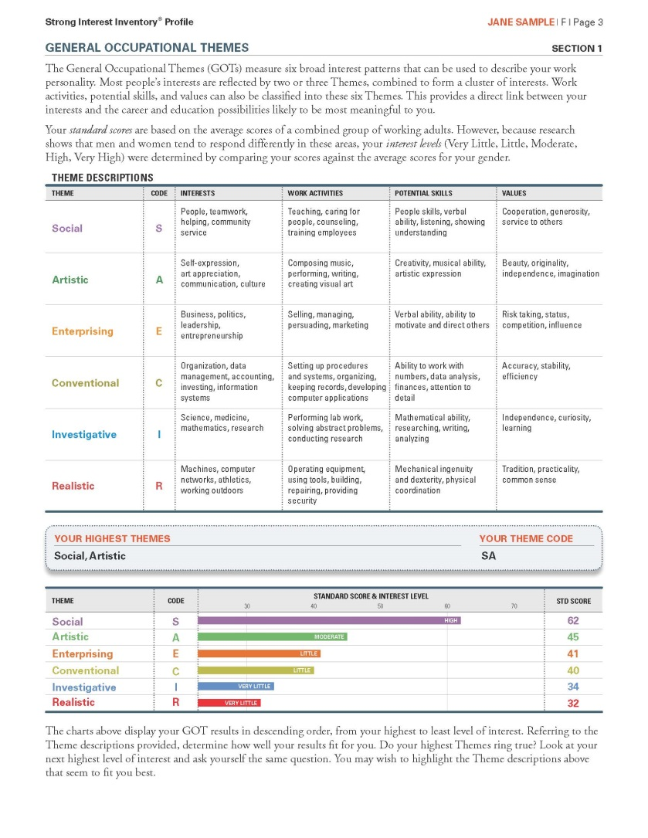
Strong Interest Inventory

Slide 6
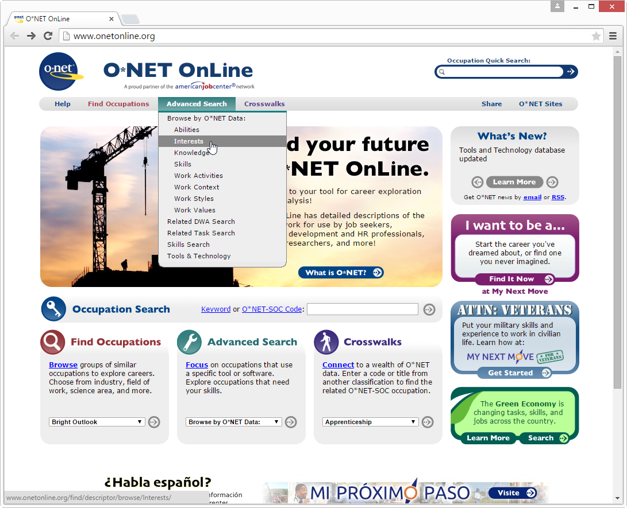
O*Net

Slide 7
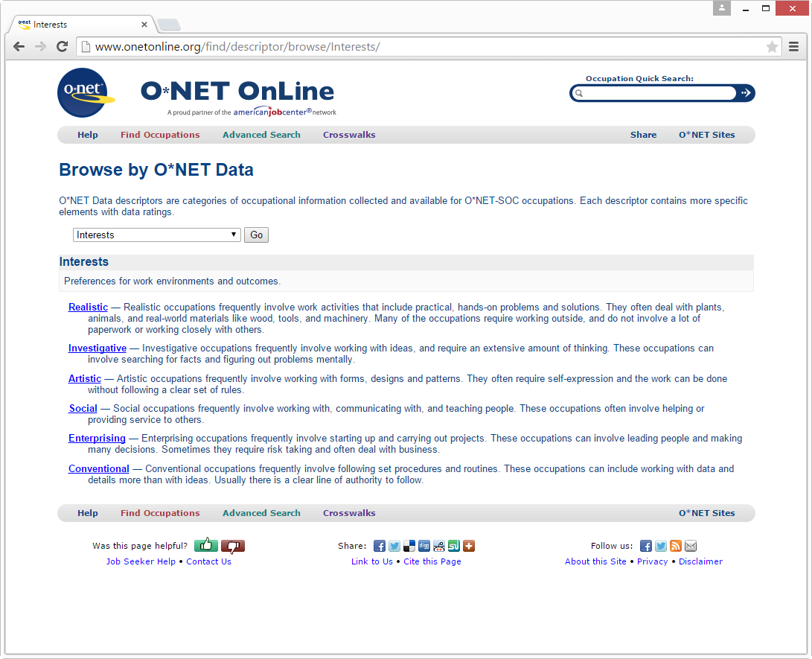
O*Net

Slide 8
Holland Theory of Careers
Holland’s Hexagon is a classification system as well as a trait-factor or talent-matching theory
Complements more modern career theories
such as:
  Planned Happenstance (John Krumboltz)
  Chaos Theory of Careers (Robert Pryor + Jim Bright)

Slide 9
The Party
The Party exercise is a group career planning activity used to generate a personalized Holland Code for participants
It was first described in the 2004 edition of Richard Bolles’ What Colour is Your Parachute
The Party assumes that people of the same personality type tend to group together

Slide 10
The Party goes
something like this..
You have been invited to a party and notice there are 6 groups of people: doers, thinkers, creators, helpers, persuaders, and organizers
You join the group that seems most like you
After some time, you join your second favourite group, then your third
Your top three groups create your three letter Holland Code, which can be used for researching career choices

Slide 11
The Past: The Party 1.0
The Party exercise has been used at Thompson Rivers University to deliver group career counselling for students for the past five years—with mixed results
The critics pointed out that the party was a problematic metaphor for engaging youth in a career planning activity

Slide 12

The Present: The Party 2.0
What would happen if the Walking Dead TV series collided with the Holland Party?
The Zombie Apocalypse Career Workshop asks a ragged band of survivors to consider their contribution to the rebuild of society after a zombie pandemic has destroyed much of their world.

Slide 13

The Present: The Party 2.0
The metaphor of an apocalyptic reboot of the world balances the concepts of freedom to explore interests with the responsibility to contribute to the rebuild of the world.
The Party 2.0 has been successfully delivered for several years to groups of prospective students.

Slide 14
The Guts & Brains
Add current pop culture references.
Recruit 6 staff with an with an understanding of career development.
Consider adding faculty from academic departments, and community members from different areas of work.
Highlight the non-linear nature of career development: talk about multiple paths to goals and the role of happenstance.
Remind participants to feed data into O*Net.

Slide 15
What Careers Fit Your Interests?
Let’s find out your top three career interest areas:
  Doer (R) Helper (S)
  Thinker (I) Persuader (E)
  Creator (A) Organizer (C)
This website guides you to careers you might be interested in:
www.onetonline.org/explore/interests/

Slide 16
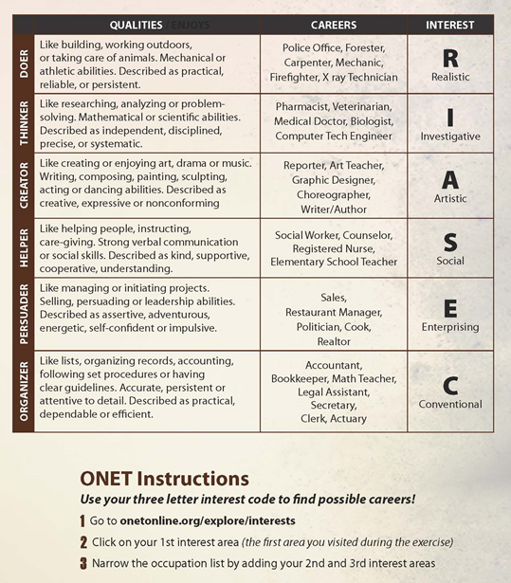

Slide 17
O*Net

Slide 18
O*Net

Slide 19


You’ve Survived the Zombie Apocalypse…
What Now?

Slide 20



Slide 21



Slide 22


Slide 23
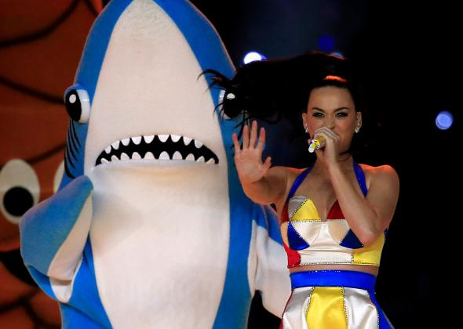


Slide 24





Slide 25




Slide 26
What role will you play?
Let’s look at your options:
    Doer (R)
    Thinker (I)
    Creator (A)
    Helper (S)
    Persuader (E)
    Organizer (C)

Slide 27

Doers- Qualities & Careers
Like building, working outdoors, and taking care of animals
Mechanical and athletic abilities
Described as practical, reliable and persistent
Police Officer
Forester
Carpenter
Mechanic
Firefighter
X-ray Technician

Slide 28
Thinkers- Qualities & Careers
Like researching, analyzing and problem-solving
Mathematical and scientific abilities
Described as independent, disciplined, precise and systematic
Pharmacist
Veterinarian
Medical Doctor
Biologist
Computer Tech
Engineer

Slide 29
Creators- Qualities & Careers
Like creating & enjoying art, drama, music, writing
Writing, composing, painting, sculpting, acting, dancing abilities
Described as creative, expressive, nonconforming
Reporter
Art Teacher
Graphic Designer
Choreographer
Writer/Author

Slide 30
helpers- Qualities & Careers
Like helping people, instructing, care-giving
Strong verbal communication and social skills
Described as kind, supportive, cooperative, understanding
Social Worker
Counsellor
Registered Nurse
Elementary School Teacher

Slide 31
persuaders- Qualities & Careers
Like selling, managing, and initiating projects
Selling, persuading and leadership abilities
Described as assertive, adventurous, energetic, self-confident, impulsive
Sales
Restaurant Manager
Politician
Cook
Realtor

Slide 32
organizers- Qualities & Careers
Like lists, organizing records, accounting, and following set procedures
Accurate, persistent, and attentive to detail
Described as practical, dependable, efficient
Accountant
Bookkeeper
Math Teacher
Legal Assistant
Secretary
Clerk

Slide 33
Discussion points For groups
What draws you to this area?
Are there specific careers you are curious about?
What types of education programs are available?
What can you be doing now to explore this field of interest?

Slide 34
Remember…
Go to onetonline.org/explore/interests and feed your three interest areas (i.e. RIASEC)
All the materials needed to run your own Zombie Apocalypse are at:
www.tru.ca/counselling/resources/cacuss2015

Slide 35
Thank You..
Cliff Robinson
Counsellor- TRU
crobinson@tru.ca
Shyann Vosper
PLAR Advisor- TRU-OL
svosper@tru.ca

