Slide 1
Cognitive Modeling for Critical Cross-Cultural Learning Angelina Van Dyke and Lorin Friesen
TESL Interiors: Landscapes of Literacies and Language
TESL Canada Conference
TRU Kamloops 2012

Slide 2
Sorry → It GREW!
Learning and studying a new language is not only about acquiring new lexical, grammatical and syntactic systems, but also about navigating culture, acquiring new paradigms, and questioning personal identity. This workshop will present and apply a simple comprehensive model of cognition which explains what is happening when language instruction and research triggers these deeper interior issues.

Slide 3
A Cognitive Approach to Language and Culture
Research began with cognitive styles
200 biographies were analyzed for data (Friesen, 1986)
This led to the concept of cognitive modules
The traits of each cognitive style could be summarized
Each set of core traits corresponded to a brain region
A model of the mind was formulated – Mental Symmetry Model
Cognitive modules function and interact in a specific way
Terms from Don Pickerell (1975)
MSM has been be used to analyze many fields
This provides corroborative evidence
It has recently been applied to the TESOL field
A single model—from personality—bridges linguistics and culture
This suggests that innate structures shape grammar
The same innate structures shape research and instruction
Connectionism functions within a general innate structure
Notes:
We should add that this model is supported by neurological evidence. Also, “connectionisms” may get confused with “connectionism” a cognitivist innatist view of second language acquisition. There is an innate structure, but a general one not limited to a specific domain (Chomsky has the idea of an innate structure, but he’s putting it within the confines of technical thought). This implies that it is erroneous to build a general theory of language learning based on technical thought (Ellis, 1998, 632, 634). Chomsky’s theory is good, but his mindset isn’t because he didn’t realize the validity of non-technical thought.

Slide 4
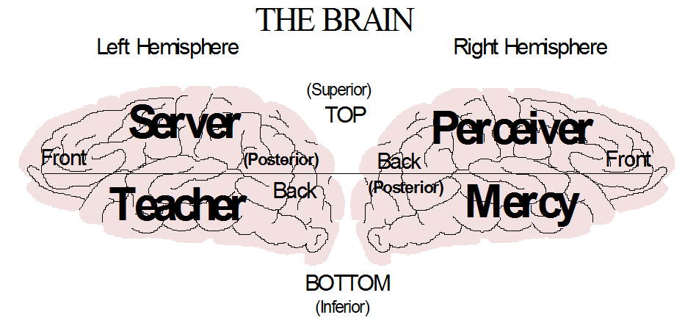
Mercy: Remembers emotional experiences; forms personal identity.
Teacher: Remembers words; builds general theories
Data: temporal; processor: amygdala; internal structure: ventral frontal
Perceiver: Looks for repeated connections; facts, objects, and maps
Server: Looks for repeated sequences; performs actions.
Data: parietal; processor: hippocampus; internal structure: dorsolateral frontal

Slide 5
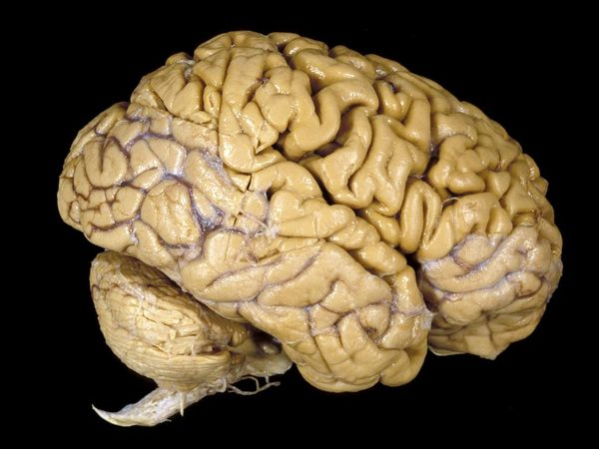
Neurological Foundations of MSM
Stuss and Levine (2002) - this study compares dorsolateral frontal with the ventromedial frontal.
Beer et al. (2003) – delineates how the orbitofrontal cortex connects emotions and identity
Rameson and Lieberman (2007) – relates self image with medial frontal cortex
Rolls and Grabenhorst (2008) - orbitofrontal cortex study which shows the difference between emotions and exhorter drive in terms of decision and reward.
Chan et al. (2009) – illustrates the difference between left and right temporal lobes
Damasio (2006) - somatic marker hypothesis – Explains relationship between physical sensation, personality, emotion, and ventromedial frontal
Cohen and Frank (2009) – summarizes the function of the basal ganglia
Notes:
The stream of language acquisition research more likely to tie in with cognitive structure is not universal grammar, but psycholinguistic analyses. It suggests that language is cut of the same cloth as other cognitive processes, and that language acquisition can be understood in terms of models of optimal (Bayesian) inference in the presence of uncertainty (Ellis, p. 637). Slobin (1973) used psycholinguistic analysis.
Lorin, there are quite a few changes here. First of all, I don’t have the reference for Cohen and Frank. Could you send it to me please? Secondly, we should list these references in alphabetical order. Thirdly, when you use the technical terms for the brain, most people won’t know what it is. For example, Damasio’s somatic marker hypothesis can more easily be summarized as explaining the neurological connection between emotion and reason, like I had it previously. If you use the terms, you should have an extra slide with a diagram naming them all.

Slide 6
From Personality to Linguistics
Analyzing how people function can be transposed onto linguistics
Notes:
Personality = cognitive styles

Slide 7
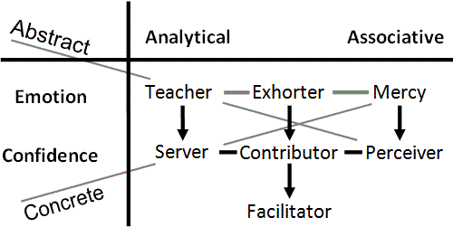
Phonemes, Morphemes & Lexis
Lives in words; morphemes; the core module for speech
Analytical thought works with sequences
Pay attention to the order of words (Slobin, 1973, p. 191)
Emotion of order-within-complexity
Wants to use exactly the right word
Looks for general theories
Overgeneralization is the most widely noted aspect (Slobin, p. 204)
General rules are learned before special case rules (Slobin, p. 205)
Hates exceptions to the rule
Avoid exceptions (Slobin, p. 205)
Notes:
Teacher thought functions at 2 levels: 1) morphemes and phonemes coming in directly from the senses – Pettito and Dunbar (2004) 2) theory is internally constructed. Therefore, we have phonemes (externally acquired) and grammar (internally constructed). Low level and high level functioning. Teacher language learners love memorizing word lists. Then they want grammar, and the exact rule and right word. Order with – in complexity at a low level and a high level. (Lorin’s brother)
You can relearn speech through singing (mercy is tones – extending phonemic vowels). Music therapy helps people speak after a left-hemisphere stroke.
Analogues to Wernicke’s and Broca’s area in the right hemisphere deal with tonal equivalents in the left hemisphere.
"...the Superior Temporal Gyrus (STG), known for its key role in phonetic processing, was functioning even in our youngest babies (~2–6 months). Because of its early brain activation, this finding suggests a biological foundation for the phonological level of human language processing, and it further suggests that this brain tissue may be mediating all infants’ universal phonetic discrimination milestone" (Pettito and Dunbar, 2009, p. 7).

Slide 8
Syntax
Follows instructions; likes recipes
Adds stability to sequences of words; syntax
Speech occurs sequentially in a rapidly fading modality (Slobin, p. 199)
Observes and copies sequences - chunking
Semantic relationship should be marked clearly (Slobin, p. 202)
Repeats sequences that work - collocations
Avoid interrupting or rearranging linguistic units (Slobin, p. 199)
Does one thing at a time
Sentence structure is preserved as a closed entity (Slobin, p. 200)
Notes:
Speech is ephemeral. Clear sequences are learned first. Servers copy actions and don’t multi-task. You see these traits together in a certain person. Language manifests this in verbal form. A typical server learner needs clear instructions and step-by step exercises, the sorts of things most other people do not like. The cognitive module nominations come from Don Pickering (Charisma Magazine) and Bill Gothard. (cf Delitzsche on Biblical Psychology)

Slide 9
Semantics
Facts and connections; semantics
Limits domain of general Teacher theories
Semantically consistent rules are acquired early (Slobin, p. 206)
Overgeneralizations are always semantically constrained (Slobin, p. 207)
Double meanings, puns, and novel metaphors
Aware of hypocrisy
A mismatch between meaning and object recognition
Jumps to conclusions.
The content side of implicature
Notes:
Traits of a perceiver and speech – changes dimension from the linguistics to the meaning – from analytical to associative – living in objects not sequences.
What aspects of speech are in the perceiver person? Meaning is important, especially unusual meaning – aware of both meanings. Perceiver thought is not emotional, but the teacher theory that you make out of the facts is emotional. They pick out the exceptions and good at deflating other people’s bubbles. Perceiver facts limits the range of teacher theory, whether the theory is right or wrong. Jumping to conclusions – they think in groups of facts, not individual facts (a mental network, mercy or teacher) is being triggered. Therefore they assume that everything being said will fall into the pattern of that mental network.

Slide 10
Lives in a world of emotional experiences
‘Who are you talking about?’
The subject of the sentence.
Finds it difficult to comprehend abstract theory
Non-verbal communication
Focuses on what is being implied
Aware of etiquette and sincerity
The politeness side of implicature
Notes:
Mercy people don’t live in words – they want examples or theories are meaningless. Language is not the central issue, but the subject of the language. They can be theoretical, but the theory is always illustrated, or they combine and mix metaphors. They are good communicators because they can put the right word pictures together to communicate meaning. They are good at mixed analogy. They are good at implicature – they read into what the other person is meaning non-verbally – politeness, sincerity, etiquette.
I’m wondering if the mercy, contributor and facilitator get nice green appellations on their slides as well! It would look better : - )

Slide 11
Great ad-lib speaker
The ‘instant expert’ who uses ‘buzzwords’
Good at motivating others
Tends to exaggerate; sees the potential
Hates being bored or frustrated
DA (dopamine) and addiction—mental networks
Parkinson’s Disease (DA↓), Exhorter is disabled (Wiecki and Frank, 2010)
LH Parkinson’s (DA↓) deficient at verb generalization (T→E) (Pinker, 1997, p. 272)
Notes:
A driver, mover and shaker – take plans and run with them
Speech is being used to accomplish ends. The first stage is the exhorter who uses words to connect the verbal and non-verbal – motivating people by taking theories and applying them to the person. Speech content is lacking – uses words in speech without using their precise meaning. He is famous for taking one or two lessons and telling people who are far more experienced what to do. They are the class clown. They give the appearance of confident fluency, but they aren’t. They hate boring exercises unless there is an important reason for it.
Lorin, what is LH Parkinson’s? Can you send the specs on Wiecki, 2010? For the bibliography? What is the relevance of Pinker’ study for Teacher and Exhorter language processing?

Slide 12
Good at learning languages
Prefers the prepared lecture
Prefers to ‘sit down and have a talk’
Skilled at reasoning and logic; hates failure
Lives on the edge; hates losing control
Technical thought
Notes:
They are not the instant expert, but the true experts in learning language. The real linguistics are contributors (opposite of the exhorter). The contributor is scared of speaking off-the-cuff. They don’t like it when you spring things on them – limited exercises, not free-flowing. They hate failure.

Slide 13
Does not like to feel muddled
Develops rules and procedures
‘Cleanses’ speech with euphemisms
Needs to know the context for object and speech recognition
Aware of everything within the context
Minimally Counterintuitive Filter (Barrett, 2004)
Rejects ‘Outliers’ which violate the context
Experiments within a fixed structure
Adjusts by mixing between information within a context
Adjusts for accent, etc.
Notes:
No direct involvement in speech, but a mindset that is attracted to structure. If it’s too open-ended, they don’t have structure – muddled. They need to know which context it is and aware of everything in that context → multi-media presentations. Facilitators are never totally giving you their full attention. Contextual learning is very important, and perceivers set the context. (Perceivers are always jumping from one context to another → facilitators may feel outwitted by them). Words – accent adjusting – certain varieties of language – adjust your filter to understand others – filtering is facilitative. Cognitively , facilitators won’t accept anything that is wildly new. You have to link to existing concepts for them to accept. They are very good at defending the status quo. Facilitators run on adrenaline.

Slide 14
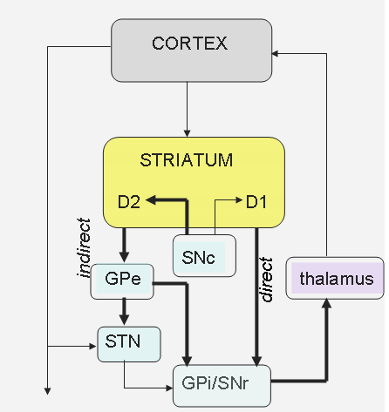
Basal Ganglia and Thalamus
Exhorter: Energy (DA) novelty, imagine, start. (direct path)
Contributor: Control, plan, optimize. (indirect path)
Facilitator: Adjust, blend, filter, average. (thalamus) (Briggs and Usrey, 2008)
Notes:
The paths go from the cortex through the striatum to the thalamus and back to the cortex. This is classic basal ganglia theory (loop). Add citation. The point is that dopamine enhances direct path through D1 receptors and suppresses indirect path through D2 receptors. The direct path is manic types → Parkinson’s patients artificially take dopamine. Language – if this is damaged you can loose your memory (aphasia) the content isn’t gone, it just doesn’t run. Mental networks are driving the direct path. Contributor and basal ganglia are difficult to connect because contributor thought is so complicated. This links to the article by Cohen and Frank (2009).

Slide 15
Activity
Think of your teaching or research style. Which of these patterns fits you best?
Recall memorable students you have had. Which thinking patterns have they demonstrated and how did it make you feel?
Notes:
Break into discussion triads – briefly for 5 minutes

Slide 16
Moving on → Linguistics, Cultural Paradigms & Identity
Mental Symmetry Model (MSM) → a meta-theory to explain and integrate various aspects of the TESOL field:
What ESSENTIAL QUESTIONS are we asking?
(Wiggins and McTighe, 2005)
1. How does MSM connect key understandings in language learning, culture and identity?
2. How can MSM help SLLs understand and manage multiple language and cultural identities?
3. How can ELT professionals use these understandings to work out solutions to ELL problems?
Notes:
How technical thought is controlling learning and mental networks. * Essential Questions can turn the whole learning enterprise technical, so be careful!

Slide 17
Thomas Kuhn Paradigms
Kuhn describe two types of thought which use the same mental circuit.
‘Revolutionary science’ is normal abstract thought, which we have just described.
Sequences and meanings are partially formed
Theories rise, fall, and change (Ptolemy → Galileo)
Certainty is analog
‘Normal science’ is technical abstract thought, which emerges when Contributor mode takes control of the mind.
Server sequences are well-formed – rules to equation assembly (eg. Force = mass x acceleration: F=ma)
Perceiver meanings are clearly defined (eg. Power = energy/time)
Limited to some Teacher theory or paradigm (eg. Newtonian physics)
Certainty is digital (eg. 3.14 vs. pi)
Notes:
Eg. Wittgenstein – the only evidence is empirical - eg. “real research”
A specialized way in which the mind can work. Contributor mode controls abstract thought by limiting server and perceiver thought – normal thought and technical thought are the same circuit being used in different ways.

Slide 18
Epistemological Crisis
Technical abstract thought (Ci) is successful
Math, logic, scientific theory, programming, grammar
Ci is emphasized in academia
Specialization, PhD thesis, papers, vocabulary
Ci is limited
It requires total certainty and builds upon axioms
It limits thinking to a ‘restricted playing field’
It optimizes and improves within a field
Using only Ci leads to an epistemological crisis
Rigorous thought has been built upon a non-rigorous foundation
Restricted playing fields do not lead to universal theories
Transformation cannot be achieved with optimization
Kuhn’s revolutionary science is an epistemological crisis
What is the alternative when Ci fails?
Notes:
Good question. We can let it hang as the evidence builds…

Slide 19
Over-use of Technical Thought (Ci) in Language
Chomsky’s generative grammar matches Ci
“Generative grammar…come[s] from formal linguistic models of often elegantly abstract mathematical structure” (Ellis, 1998, p. 632).
“This] concentrates the study of language on grammar, ignoring such areas as lexis, fluency, idiomaticity, pragmatics and discourse” (Ellis, p. 634).
An epistemological crisis in studying language:
Use Ci: Initially researchers used technical thought to study language.
Rigorous typological analysis arrives at language universals, not impressionistic data gathering (Greenberg, 1975, p.79)
More than Ci: Technical thought cannot analyze all aspects of speech.
Verbal meaning comes from metaphor, not logic (Lakoff & Johnson, 1980)
An epistemological crisis in language teaching:
Teaching language was equated with teaching grammar
Krashen pointed out this fallacy with his acquisition-learning distinction (Krashen, 1982, p. 10)
Current debates in SLA: Ortega (2011), Gregg (2006) vs Watson-Gegeo (2005) innatist or emergentist?
Notes:
Chomsky is stuck in technical thought. He ignores the other parts of language that fall outside of technical thought. Typological analysis = formal logic
Lakoff → meaning is built on metaphors, not logic (mental networks). Krashen precipitated a discussion of learning language, but his methods crashed.
I wonder if we shouldn’t title this slide “Major Shifts in Studying and Teaching Language”
Make sure to be conversant with Ortega’s epistemological commentary and Gregg vs. Watson Gegeo.

Slide 20
Normal Abstract Thought -Community of Practice (CoP)
Creating Intellectual Capital (O’Donnell, 2003)
Language can be viewed as a CoP (Hall, 2006, p. 232)
Teams and CoPs are fundamentally different kinds of groups (O’Donnell, p.4)
CoP describes normal abstract thought
Informally bound by shared expertise (p.3)
Cannot be managed in the traditional control-oriented manner (p.4)
As topics shift some may leave and new people may join (p.4)
Defined by opportunities to learn, share, and critically evaluate (p.4)
Search for reasons, patterns and logic (p.5)
Attempts to make sense of experience (p.5)
Members gradually agree on boundaries (p.6)
Operates through ‘validity claims of propositional truth’ (p.7)
Team describes technical concrete thought (Cp)
Teams are tightly integrated units driven by deliverables (p.4)
Teleological, means-end or goal-oriented (p.4)
Teams have clear boundaries, set rules, and memberships (p.4)
Team managers threaten the function of CoP (p.8)
Notes:
CoP describes more of what is happening in speech. This describes integrated cognitive processing, or normal abstract thought.

Slide 21
Implicature
Speech fills in the blanks and jumps to conclusions
Implicature goes beyond both normal and technical thought
Implicature was first analyzed using technical thought (Grice,1975).
The cooperative principle: Guided by a teacher theory
Maxim of manner: Use well-formed Server statements
Maxim of quality: Convey Perceiver meaning
Maxim of relation: Stay within the Contributor playing field
Maxim of manner: Pursue Teacher order-within-complexity
However, technical thought cannot explain implicature → post-Griceans
Grice is not including social interaction (Lindblom, 2001)
Grice has a logical bias (Davies, 2007)
Children do implicature but lack technical thought (Sperber & Wilson, 2002)
→ How does one explain implicature?
Notes:
Four points of technical thought match up in the maxims – Grice is describing technical thought! For illustration refer to Gabriolatos (1999).
This is the introduction to mental networks. He is describing something that is not technical and not normal → a third thing

Slide 22
Mental Networks (MN)
Friesen (2012, pp. 38-42)
Isolated memories feel good or bad
Similar emotional memories will connect
A mental network will form
Triggering one memory activates them all
Compatible input creates hyper-pleasure
Incompatible input produces hyper-pain
Incompatibility threatens the network
There will be deep unease
‘Feeding’ the network removes unease
A MN can contain painful memories
Eg. the abused spouse
A ‘starved’ network will ‘die’
It will act again as isolated memories

Slide 23
Mental networks in Operation
The mind represents people as MNs; eg. change or death of loved one
Agency Detector: Input will trigger MNs that represent people
Theory of Mind: A triggered MN will predict consistent input
Pretense plays a major role in the child (Piaget, 1972)
Pretense is the basis for Theory of Mind (Leslie, 1987)
Does a technical mechanism distinguishes self from others? (Leslie)
Self is the set of MNs that cannot be ignored
Children are guided by schema and self-schema (Piaget, 1926)
Cognitive linguistics and schemata (Ellis, p. 634)
Implicature: Triggered MNs will ‘fill in the blanks’
Implicature is cognitively efficient (Sperber, 2002) (eg. look-up table)
Implicature often attempts to influence others (Sperber, p. 21)
Implicature assumes relevance (Sperber, p. 24)
The Sentence: Most languages are SVO or SOV
Which MN is being triggered and how does it behave? (Mercy-based)
SVO is natural even if not present in L1 and L2 (Håkansson, 2002, p. 253)
Notes:
Language Origins – children – a structure for universal grammar that is not universal grammar but universal structure organized in mental networks beginning with mercy identity. Dual process - type 1 = intuitive can be irrational; type 2 = technical and can try to override type 1, and if repeated enough can turn in to type 1. Being locked into technical thought is a mental network which grows under the technical thought just because you are working within a paradigm.
Include negative questions – are people constrained culturally to answer in the negative or the positive? Eg. Didn’t you bring an umbrella along? Yes, I didn’t (wrong in Western mind) No, I didn’t (correct).

Slide 24
Politeness Theory
Politeness cannot be explained using technical thought
“The Gricean model of communication makes it difficult to look beyond the cognitive processes by which one individual produces or interprets a single, isolated utterance act” (Arundale, 1999, p. 147).
Uses a co-constituting model for implicature and politeness (p. 126)
Politeness is the emotional side of MNs
Other people are internally represented as MNs
Social interaction triggers MNs
MNs have three main attributes:
A MN should not be suppressed (I exist)
A MN wants input that is consistent with its structure (Allow me to function)
A MN should contain memories with good emotions (Be nice)
These attributes can explain the three main aspects of Brown and Levinson’s (1987) politeness theory:
Positive face = activate MN with consistent, positive data
Negative face = suppress, ignore or override MN
Negative politeness = activate MN without imposing your structure
Hidden Impoliteness = surface politeness with deeper disregard → there is an order to politeness.
Notes:
Politeness and implicature are a single mechanism. Positive face - it’s worse to be ignored than to be insulted. Facilitators activate positive or negative face, able to listen politely with a closed mind, whereas the contributor will shut you down or control you. This is a mental network behind the technical thought, which has trapped them. It kicks in when you question the validity of their paradigm. Negative politeness = indirect questions like “Do you know what the time is?” Trigger a structure and allow another persons mental network to flow once it’s been triggered. Implicature at its best.
The co-constituting model is one where each interlocutor is activating mental networks in the other person to effect a desired response (theory of mind). This is why politeness is co-constituted.

Slide 25
Culture
Social interaction is based in mental structure (Friesen, 2012)
Simple logic: there are no brain cells out there!
Interaction occurs mentally between MNs that represent people.
Culture is a shared set of MNs that resonate
Eg. special interest groups forming over the Internet
Most of these shared MNs were acquired in childhood
Core MNs impose structure on lesser MNs
Core MNs may represent powerful people – social interaction often can bring up the topic of power struggles
Cross-cultural interaction triggers inconsistent MNs
Exhorter novelty comes first (3 months), then fragmentation
A technical definition of identity is the MNs that cannot be ignored
Notes:
Everyone thinks culture is social, but it’s based in the mind. Harmony, “wa”. Shifting from linguistic to cultural side of linguistics. The point is that we talk about social interaction, but there is no social memory (Arundale quote). Instead people are acquiring similar mental networks and people resonate with each other. Eg. Special interest groups on the internet. Vygotsky’s social interaction – ZPD – zone of proximal development – enter into the culture of the child – scaffolding.

Slide 26
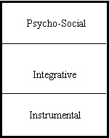
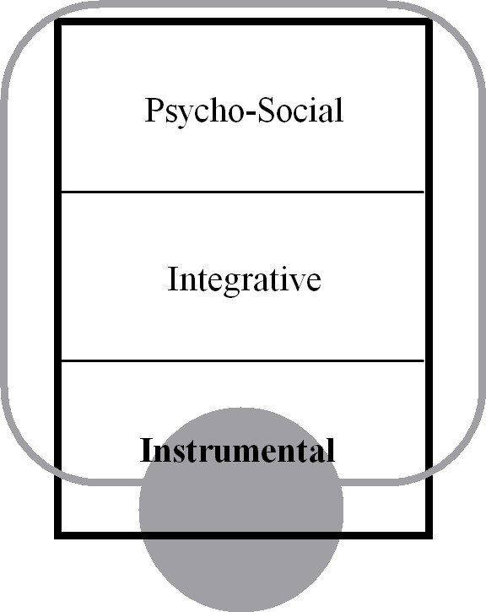
Intercultural Interaction Model Acculturation Attitudes in SLA (Culhane, 2004)
Psycho-social: Core MNs are affected
Integrative: Peripheral MNs are affected
Instrumental: MNs are not involved
Marginalized
No L2/C2 MNs have formed
(Leaving C2 may uncover acquired MNs)
L1/C1
L2/C2
Notes:
Mental networks pop up when they are violated. Mental networks can form without you knowing it. Consistent networks stay in the background and aren’t challenged – mental glow.

Slide 27
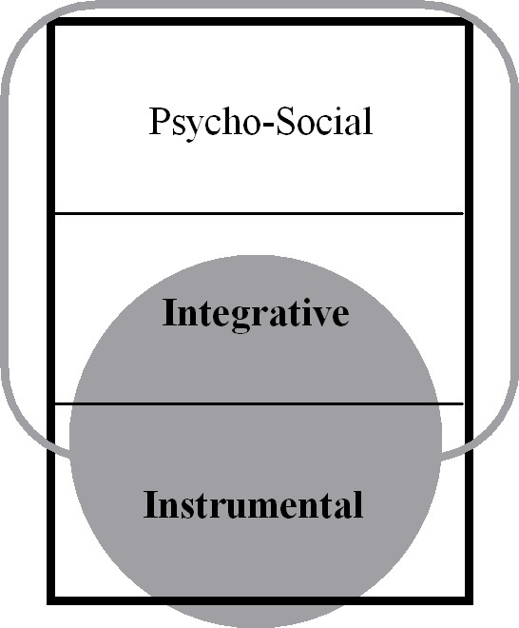
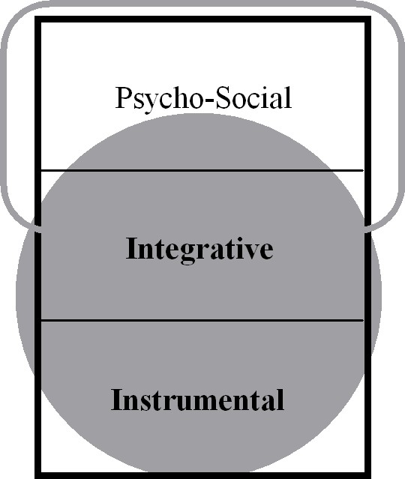
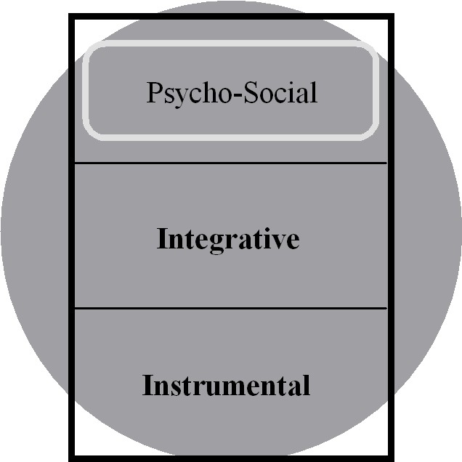
Separated
Peripheral MNs of L2/C2 have been acquired. Core MNs of L1/C1 drive behavior.
(Gives the appearance of cultural assimilation Because C1 is not public)
Integrated
Some core MNs of L2/C2 have been acquired.
(Can lead to L1+L2/C3, In which C3 is a combination of C1 & C2—third culture kids)
Assimilated
Only core MNs of L1/C1 remain.
(Further assimilation will threaten core MNs and may trigger a backlash)
Notes:
Segueway into next slide: Further assimilation resists dissection – eg. Africa and colonization

Slide 28
The Power of Mental Networks
MNs resist dissection
People react when others analyze their MNs (Kubota, 1999). It’s easier to analyze mental networks in others’ minds!
MNs can overwhelm technical thought
Global warming research
MNs can overwhelm normal thought
Google ‘krashenburn’
MNs can infect technical thought
The MN lies hidden behind the technical thought
Alternate viewpoints often ridiculed (Kuhn, 1962)
Notes:
Technical thought pretends it is immune to emotional pressure and power games. This provides a rigorous way for suggesting why and how it happens because of similar emotional memories (MNs). MN can’t be dealt with objectively, because it will try to highjack the discussion, because it wants consistent information. Eg. Person A analyzes a mental network in person B – person B feels dissected and starts to scream – vivisection.

Slide 29
Brief Reflection
Describe how mental networks have affected the learning process in your classroom.

Slide 30
Habermas
A Cognitive Examination of his first two Social Stages
Habermas describes the visible result of a mental shift involving Mercy and Perceiver
Mercy thought remembers emotional experiences
Perceiver thought looks for facts--which organize and connect Mercy experiences
Representative publicity (Mercy emotions overwhelm Perceiver thought)
The emotional status of the leader is paramount
The lord and master has an ‘aura’ that is displayed to his subjects; Versailles tried to overpower the senses
This emotional status overwhelms Perceiver thought
The public watches and acclaims the leader; the leader proclaims truth to his subjects
Bourgeois public sphere (Perceiver thought is functioning)
Facts are no longer accepted blindly from the leader: People questioned absolute sovereignty
Perceiver thought looks for facts: News and information became important
Perceiver facts connect Mercy experiences: Travel and trade built connections
Perceiver facts organize Mercy experiences: Private property and personal identity were defined
Perceiver thought tests facts: There was a critical press, and debates in coffeehouses
Perceiver facts are independent of Mercy emotions: The rule of law replaced the monarch’s edict
Notes:
Great. Habermas describes how perceiver confidence interacts with mercy emotions. Habermas is looking at this socially, but there is something behind this, which is looking at it cognitively, since people and society are represented as MNs in the mind. Perceiver thought is another way of describing critical thought at its core.
A Study in History - a growing civilization has challenges → it will continue growing if the challenges are met adequately, but a society will be stunted if the challenges are too overwhelming eg. Inuit living in frozen north → all energy is put toward survival.
In his third social stage, perceiver thought is inundated with mass media → the universal replication of information that forms emotional status (M) and defines truth (P). Thus, the private sphere is inundated.

Slide 31
Male vs. Female Development
Male: Perry (1970)
Males ignore MNs to develop P.
Dualism: P is mesmerized by MNs
Multiplicity: P is not mesmerized but also not functioning
Procedural Knowledge: P is functioning
Constructed Knowledge: P applies increasingly to MNs
Female: Belenky (1986)
Females learn to manipulate MNs.
Silence: Other MNs suppress identity
Received Knowledge: Other MNs define identity
Subjective Knowledge: MNs define P ‘truth’
Procedural Knowledge: P evaluates MNs
Constructed Knowledge: P manipulates MNs
Notes:
Previous slide is an illustration of mercy emotions overwhelming perceiver thought in a social setting. Male and female process of perceiver thought and mercy emotions – tie it into mental networks. In the male MNs are ignored, and perceiver explicitly developed → mesmerized, confused, functioning, and in females MNs are never ignored, but gain the ability to compare and evaluated and tear apart and combine → perceiver confidence is gained. Add Magolda’s recent research on male and female development. Great. Perry’s study was at Harvard, done predominantly on males. Belenky added the female side to intellectual development. This is very significant!
Dualism = looking to the experts. Multiplicity = teenager thing of questioning and confusion. Procedural = learning on mechanical objects (or treating women like they are).
Women are more subjective processors, interested ultimately in manipulating MNs, whereas men initially run away from MNs, being more objective, and return to MNs to apply knowledge to them.

Slide 32
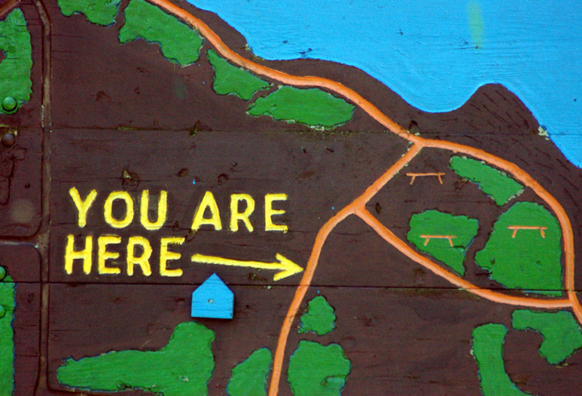
Concrete Thought
WHAT DOES IT MEAN TO BE AN INDIVIDUAL PERSON?
Emotional Mercy experiences provide the raw material
Perceiver facts arrange experiences into a map
Goals are emotional; emotions can overwhelm facts (peripheral or core?)
Inescapable MNs define personal identity (You are here)
Placing personal identity within a map requires Perceiver confidence
Mental networks demand consistent behavior whether acknowledged or not
Contributor thought chooses action based on location
Are there reliable connections of cause-and-effect?
Do choices exist?
Server actions lead from one experience to another
Does a path exist? Do I have the necessary skills?
Notes:
What does it mean to be an individual? How many elements are being addressed, and at what level are we descending → what it means to be an individual. I am making the choice – what is affecting identity – based on cause and effect- what is the emotional goal and how do we build the map, and how does personal identity fit in? In order to make a choice you have to have perceiver fact map, and an emotional goal. Personal identity is another step further. It asks where you are in the map, and where you fit in. Are you related to any map? Perceiver confidence precedes travelling the map. Intellectual abstract thought gives you confidence to know who and where you are. To be self-observant and aware of where you are. To be able to look at yourself.

Slide 33
Possible Selves
Inescapable MNs define personal identity
Any MN is potentially a self
MNs that are always repeated are inescapable
These MNs are defined by the physical body, knowledge, and skills
The ‘actual self’ (Higgins, 1987)
Perceiver confidence is required to recognize this inescapability
Motivation becomes intrinsic when the MNs are inescapable—and the mind recognizes this
MNs with strong emotions feel inescapable—when triggered
These MNs are defined by parents, culture, and authority figures
The ‘ought self’ (Dörnyei 2009, p. 13; Higgins, 1987)
The ‘feared self’—if emotions are negative (Carver, 1999)
There will be a multiplicity of inconsistent MNs
Perceiver thought looks for connections and contradictions
Strong emotions tend to overwhelm Perceiver thought
Motivation is extrinsic because MNs that represent other people are emotionally imposing themselves upon the actual self
Perceiver confidence increases the ability to manipulate MNs
Perceiver confidence is insufficient when dealing with core MNs
Core MNs can only be changed by playing one MN against another
Notes:
The “ought” self – strongest emotion when triggered – mercy – expectations. There are two ways MNs are inescapable → Lorin will rework.
Possible selves – perceiver (they fight). Grow ability to manipulate these “Just saying ‘no’ is not enough” This is perceiver confidence.
There is nothing here on Bonny Norton, and her imagined identities, social identity, investment and language learning. Refer to it.
Ideal self → Norton’s (1997) definition has no internal consistency because she is denying that messed up mental networks can be transformed (p. 419). TESOL presumes cultural change and transformation, but Norton deconstructs this and has no alternative – deconstructs the whole field of linguistics and thus, teaching. Deconstructionism assumes no absolutes – how does one form meaning to words that are the same between you and another person -- localized forms of English → no more universals. Japanese women view English as cultural liberation b/c they can freely express their opinions → if we are edging on moral issues here, let’s come up with a definition consist with linguistics and not deconstruct ourselves. Because you are looking at cognitive modules are showing in culture and linguistics, it also shows up in morality, cf. Kholberg Certain principles from linguistics have moral application – four modes of thought (perceiver thought analyzes and compares cultures – implication is that some statements will be negative; teacher can impose regularity on language – language institutes; server forms sentence structure; mercy works within structure to affirm personal identity – not ignored ) Sequeway , when you start to analyze culture and treat it as unchangeable and irreducibly complex (Norton, 1997), then you end up deconstructing linguistics because words lose meaning and you can’t communicate. The implication is deconstructing linguistics. Is it possible to construct a morality that saves linguistics?

Slide 34
Two Kinds of Mental Networks
Two kinds of mental networks (Friesen, 2012, pp. 85-87)
A MN forms when there are related emotional memories
Emotional Mercy experiences can form MNs (MMN)
A MMN demands input that is consistent (‘my way or the highway’)
Culture, people, situations, and even objects
General Teacher theories can form MNs (TMN)
A language forms a TMN
A TMN demands to impose its explanation
‘If I talk louder and more slowly, maybe they will understand me’
Paradigms have emotional power (Kuhn, 1962)
Self-motivated learning (a powerful form of internal motivation)
Implicature can be driven by common sense, which is a TMN
Two kinds of ‘culture shock’
Incompatible experiences threaten MMNs (anomie)
Lack of understanding threatens TMNs
Kuhn: A scientist cannot exist without a paradigm
Notes:
Just a note on third-culture kids - research by Acton (1979),and subsequent research afterwards shows that the optimal social distance for learning a new language is when learners' general cultural attitudes were at a midpoint between their original cultures and the culture of their second language. This corroborates with what we were saying about learners wearing a type of "spacesuit" to insulate themselves from feeling non-native. The whole idea of social distance came from Schumann’s (1978) Acculturation Model of SLA, where success in SLA (SSLA) is inversely proportional to the social distance (SD) between the second language learning and target language communities (in Scovel, p. 25). SSLA = 1/SD

Slide 35
Theory vs. Identity
A TMN can conflict with an MMN
This is a ‘cultural’ conflict between theory and identity
Objective science avoids triggering MMNs
TESOL studies both linguistics and culture
“Linguists may assume, as Noam Chomsky does, that questions of identity are not central to theories of language, we as L2 educators need to take this relationship seriously.” (Norton, 1997)
Acquiring a new TMN questions existing MMNs
Thinking and dreaming in French led to ‘anomie’ (Lambert, 1972)
Paradigms alter viewing the world; incommensurability (Kuhn, 1962)
Migration & mass media expand imagined communities (Kanno, 2003, p. 246)
Some perceived social distance helps language acquisition (Acton, 1979)
Online discussion groups (Merryfield, 2001)
MMNs can disable theorizing
“The authors appear to have very consistent conceptions of identity. First, they all see it as complex, contradictory, and multifaceted and reject any simplistic notions of identity.” (Norton 1997, p. 419)
MMNs can deconstruct linguistics itself
Should there be an international standard for English?
Notes:
Just a note on third-culture kids - research by Acton (1979),and subsequent research afterwards shows that the optimal social distance for learning a new language is when learners' general cultural attitudes were at a midpoint between their original cultures and the culture of their second language. This corroborates with what we were saying about learners wearing a type of "spacesuit" to insulate themselves from feeling non-native. The whole idea of social distance came from Schumann’s (1978) Acculturation Model of SLA, where success in SLA (SSLA) is inversely proportional to the social distance (SD) between the second language learning and target language communities (in Scovel, p. 25).
SSLA = 1/SD

Slide 36
Minimizing the Pain
Cultural dislocation is painful; MMNs are fragmenting
Protecting culture is counterproductive
Culture and language become viewed as a power struggle (Norton, 1997)
One MMN is imposing itself upon another; hyper-pain motivates
Experiencing cultural dislocation is productive—Third culture kids (Pollock, 2009)
TCKs do struggle with unresolved personal issues; MMNs are fragmented
TCKs do have questions of identity and find personal commitment difficult
But, TCKs understand and adapt easily to different cultures
And, TCKs have a larger worldview and enjoy crossing cultures
What helps the TCK?
A TMN can act as a ‘spacesuit’ to minimize feelings of anomie
The skilled expat has a spacesuit, the immigrant doesn’t
81% of TCKs earn at least Bachelor’s degrees vs. 21% (Cottrell & Unseem, 1993)
A meta-theory like MSM can help in a more general way
A TMN can create the image of a more ‘ideal self’
It is ideal because Teacher thought is combining, simplifying, and idealizing (eg. Geometry and Platonic forms)
Imagined communities become a hope to motivate personal improvement (Kanno and Norton, 2003, p. 248).
A TMN expands worldview
Theories are general; experiences are specific
A person views himself as part of a larger group
Notes:
Cottrell, A.B. and Useem, R.H. (1993). TCKs four times more likely to earn bachelor's degrees. NewsLinks-The Newspaper of International Schools Services. 7 (5), Princeton, NJ.
Just a note on third-culture kids - research by Acton (1979),and subsequent research afterwards shows that the optimal social distance for learning a new language is when learners' general cultural attitudes were at a midpoint between their original cultures and the culture of their second language. This corroborates with what we were saying about learners wearing a type of "spacesuit" to insulate themselves from feeling non-native. The whole idea of social distance came from Schumann’s (1978) Acculturation Model of SLA, where success in SLA (SSLA) is inversely proportional to the social distance (SD) between the second language learning and target language communities (in Scovel, p. 25). SSLA = 1/SD

Slide 37
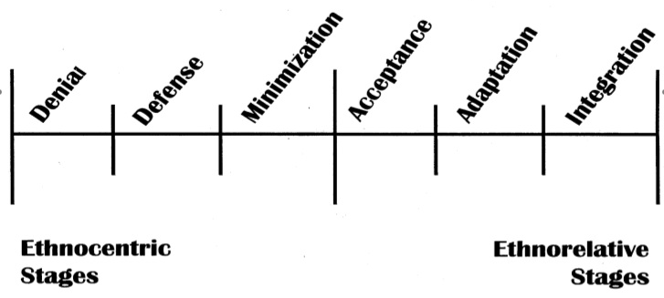
Bennett Scale (DMIS)
Developmental Model of Intercultural Sensitivity
Denial: No conflicting MNs are triggered
Defense: One MN imposes structure on other MNs
(ought self)
Minimization: Core MNs are assumed while peripheral MNs may change
Acceptance: TMN brings order to complexity of multiple MMNs
(actual self)
Adaptation: Multiple MMNs are incorporated within a universal TMN
Integration: MMNs of personal identity are incorporated within a universal TMN
(ideal self)
Notes:
Mercy and teacher emotions. Are we just satisfied when a general teacher theory pulls together existing mercy mental networks (current state of Christianity and acceptance stage → Hofstede), or do we want to reach further and allow a teacher mental network to transform existing mercy mental networks? = dying to self.

Slide 38
Some Application
Include the language of MSM in your discussions
Problem 1: You have been assigned to teach a classroom of Korean school children for a week of English and culture classes. How would you modify your expectations and approach?
Problem 2: You have a news media and debate class of international students from all over the globe, half of which are mainland Chinese. The classroom atmosphere is tense, particularly when students raise issues between China and Japan. How do you enable students to resolve conflict and move the class forward?
Problem 3: You are teaching native speaker and multilingual students in a collaborative problem-based TESOL program, where private reflection is elicited from group members concerning their contributions and the contributions of others. The module went badly, and several students are questioning the validity of non-native speaker participation in the program. How do you both build trust in the program design and validate the concerns raised?
Notes:
Elicit from participants the scenarios that come to the fore of their minds.

Slide 39
References
Arundale, Robert B. (1999). An alternative model and ideology of communication for an alternative to politeness theory. Pragmatics 9(1), 119
Arundale, Robert B. (2006). Face as relational and interactional: A communication framework for research on face, facework and politeness. Journal of Politeness Research 2, 193-216.
Barrett, J. L. (2004). Why would anyone believe in God? Altimira Press.
Barrett, Terry and Moore, Sarah. Ed. (2011). New Approaches to Problem-Based Learning: Revitalizing your Practice in Higher Education. New York: Routledge.
Beaumont, John. (2010). A sequence of critical thinking tasks. TESOL Journal 1.4, 1-22.
Beer, Jennifer S. et al.(2003). The regulatory function of self-conscious emotion: Insights from patients with orbitofrontal damage. Journal of Personality and Social Psychology 85 (4), 594–604.
Belenky, M.F., Clinchy, B. M., Goldberger, N.R., Tarule, J.M. (1986). Women’s ways of knowing: The development of self voice and mind. New York: Basic Books Inc.
http://collegestudentdeveltheory.blogspot.ca/2010/10/womens-ways-of-knowing-synopsis-by-e.html
Bennett, M. J. (1986). Towards ethnorelativism: A developmental model of intercultural sensitivity. In R.M. Paige (Ed.), Cross-cultural orientation: New conceptualizations and applications (pp. 27– 70). New York: University Press of America.
Bennett, M. J. (1993b). Towards ethnorelativism: A developmental model of intercultural sensitivity. In R.M. Paige (Ed.), Education for the intercultural experience (pp. 21–71). Yarmouth, ME: Intercultural Press.
Bloom, B.S. (1956). Taxonomy of educational objectives. Boston, MA: Allyn and Bacon.
Briggs, Farran and Usrey, Martin W. (2008) Emerging views of corticothalamic function. Current Opinions in Neurobiology. 18(4), 403–407. doi:10.1016/j.conb.2008.09.002.
Brown, Penelope and Levinson, Stephen C. (1987). Politeness: Some Studies in Language Universals. Studies in Interactional Socioinguistics 4. Cambridge UP.
Chan, Dennis et al. (2009). The clinical profile of right temporal lobe atrophy. BRAIN: a Journal of Neurology 132, 1287-1298.
Cohen, Michael X. and Frank, Michael J. (2009). Neurocomputational models of basal ganglia function in learning, memory and choice. Behavioural Brain Research . 199(1), 141–156.
Cook, Vivian. Krashen’s Comprehension Hypothesis Model of L2 Learning. Retrieved from http://homepage.ntlworld.com/vivian.c/SLA/Krashen.htm
Cook, Vivian. The poverty-of-the-stimulus argument and structure-dependency in L2 users of English. IRAL 41, 201-221.
Cottrell, A.B. and Useem, R.H. (1993). TCKs four times more likely to earn bachelor's degrees. NewsLinks-The Newspaper of International Schools Services. 7 (5), Princeton, NJ.
Culhane, S.F. (2004). An intercultural interaction model: Acculturation attitudes in second language acquisition. Electronic Journal of Foreign Language Teaching, 1(1). Retrieved from http://e-flt.nus.edu.sg/v1n12004/culhane.htm#3%20%20Acculturation%20attitudes
Damasio, Antonio. Descarte’s Error. (1994, 2006). USA: Penguin Books, getAbsract.
Damasio, Antonio. (1999). The Feeling of What Happens: Body and Emotion in the Making of Consciousness. Heinemann: London.
Davies, Bethan L. (2000). Grice’s Cooperative Principle: getting the meaning across. Leeds Working Papers in Linguistics 8, 1-26.
Davies, Bethan L. (2007). Grice’s Cooperative Principle: Meaning and rationality. Journal of Pragmatics 39, 2308-2331.
Davis, Wayne. (2007). Implicature: Intention, convention, and principle in the failure of Gricean theory.
Dornyei, Zoltan. (2002). Motivation and Second Language Acquisition. Honolulu, Hawaii: Univ. of Hawaii Press.
Dornyei, Zoltan. (2003). Attitudes, orientations and motivations in language learning: Advances in theory, research and applications. Nottingham, UK: University of Nottingham Press.

Slide 40
References
Ellis, Nick C. (1998). Emergentism, connectionism and language learning. Language Learning 48(4), 631–664.
Elman, Jeffrey L. Connectionism and language acquisition. (2001). In M. Tomasello and E. Bates (Eds.) Essential Readings in Language Acquisition. Oxford: Basil Blackwell.
Friesen, Lane. (1986). Cognitive Styles in History: Perceiver and Mercy, first ed. Lane Friesen, Inc.
Friesen, Lane. (1986). Cognitive Styles in History: Contributor and Server, first ed. Lane Friesen, Inc.
Friesen, Lorin. (2012). God, Theology, and Cognitive Modules: A General Theory of Human Thought. Abbotsford, BC: Lorin Friesen.
Gabrielatos, Costas. (1999). Inference: Procedures and Implications for TEFL. TESOL Greece Newsletter 6, 15-20.
Gardner, R.C. (2007). Motivation and Second Language Acquisition. University of Western Ontario. Porta Linguarum 8, 9-20.
Goldberg, Adele E. (2004). But do we need universal grammar? Comment on Lidz et al. (2003). Cognition 74, 77-84.
Greenberg, Joseph H. (1975). Research on Language Universals. Annual Review of Anthropology 4, 75-94.
Grice, Paul. (1989). Studies in the Way of Words. Harvard, USA: Harvard UP. Chapter 2: Logic and Conversation.
Goel, Vinod and Dolan, Raymond J. (2003). Explaining modulation of reasoning by belief. Cognition 87, B11-B22.
Gregg, Kevin R. (2003) The state of emergentism in second language acquisition. Second Language Research, 19(2), 95-128.
Gregg, Kevin R. (2006). Taking a social turn for the worse: the language socialization paradigm for second language acquisition. Second Language Research 22 (4), 413–442.
Gumperz, John J. and Levinson, Stephen C. (1991). Rethinking linguistic relativity. Current Anthropology. 32(5), 613-623.
Hakansson, Gisela; Pienemann, Manfred; Sayelhi, Susan. (2002) Transfer and typological proximity in the context of second language processing. Second Language Research 18(3), 250-273.
Hammer, Mitchell R., Bennett, Milton J., Wiseman, Richard. (2003). Measuring Intercultural Sensitivity: The intercultural development inventory. International Journal of Intercultural Relations 27, 421-443.
Higgins, Tory E. (1987). Self-discrepancy: A theory relating to self and affect. Psychological Review, 94(3), 319-340.
Hofstede, Gert Jan, Pederson, Paul B., Hofstede, Geert. (2002). Exploring Culture: Exercises, Stories and Synthetic Cultures. Yarmouth, ME: Intercultural Press, Nicholas Brealey Publishing.
Jackendoff, Ray. (2002). Foundations of Language: Brain, Meaning, Grammar, Evolution. New York: Oxford UP.
Jonassen, David H. (2011). Learning to Solve Problems: A Handbook for Designing Problem-Solving Learning Environments. New York and London: Routledge.
Kanno, Yasuko and Norton, Bonny. (2003). Imagined communities and educational possibilities: Introduction. Journal of Language, Identity and Education, 2(4), 241-249.
Krashen, Stephen. (1982). Principles and Practice in Second Language Acquisition. University of Southern California.
King, P. M., & Kitchener, K. S. (1994). Developing reflective judgment: Understanding and promoting intellectual growth and critical thinking in adolescents and adults. San Francisco, CA: Jossey-Bass.
Koroshetz, and Steven Pinker. (1997). A neural dissociation within language: Evidence that the mental dictionary is part of declarative memory, and that grammatical rules are processed by the procedural system. Journal of Cognitive Neuroscience 9(2): 266-276.
Kubota, Ryoko. (1999). Japanese culture constructed by discourses: Implications for applied linguistics research and ELT. TESOL Quarterly, 43(1), 9-35.
Kuhn, Thomas S. (1962). The Structure of Scientific Revolutions. Chicago UP, 1962, 1970, 1996.

Slide 41
References
Lakoff, George and Johnson, Mark. (1980). The metaphorical structure of the human conceptual system. Cognitive Science 4, 195-208.
Leudar, Ivan; Costall, Allan; Francis, Dave. (2004) Theory of mind: A critical assessment. Theory and Psychology 14, 571.
Leslie, Alan M. (1987). Pretense and representation: The origins of “Theory of Mind”. Psychological Review 94(4), 412-426.
Lightbown, Patsy M. and Spada, Nina. (2006). How Languages are Learned, 3rd ed. Oxford: Oxford UP.
Lindblom, Kenneth. (2001). Cooperating with Grice: A cross-disciplinary meta-perspective on uses of Grice’s cooperative principle. Journal of Pragmatics 33, 1601-1623.
Merryfield, Merry, M. (2001). The paradoxes of teaching a multicultural education course online. Journal of Teacher Education. 52(4), 283-289.
Myles, Florence. (2010). The development of theories of second language acquisition. Language Teaching. 43(3), 320-332. Cambridge UP.
Nisbett, Richard E.; Choi, Incheol; Peng, Kaiping; Norenzaya, Ara. (2001). Culture and systems of thought: Holistic versus analytic cognition. Psychological Review 108(2), 291-310.
Norton, Bonny. (1997). Language, identity and ownership of English. TESOL Quarterly 31(3), 409-429.
Norton, Bonny. (2000) Identity and Language Learning: Identity, Gender Ethnicity and Educational Change. Language in Social Life Series. Ed. Christopher N. Candlin. Harlow, England: Longman Pearson Education.
Norton Pierce, Bonny. (1995). Social Identity, Investment and Language Learning. TESOL Quarterly, 29(1), 9-31.
Norenzaya, Ara and Heine, Steven J. (2005). Psychological universals: What are they and how can we know? Psychological Review 131(5), 763-784.
Nuckolls, Janis B. (1993). The semantics of certainty in Quechua and its implications for a cultural epistemology. Language in Society, 22(2), 235-255.
O’Donnell, D., Porter, G., McGuire, D., Garavan, T. N., Heffernan, M. & Cleary, P. (2003). Creating intellectual capital: A Habermasian community of practice (CoP) Introduction. Journal of European Industrial Training 27, 2,3,4; 80-87.
Ortega, Lourdes. (2011). SLA after the social turn: Where cognitivism and its alternatives stand. (ch. 7). In Dwight Atkinson (Ed.). Alternative Approaches to Second Language Acquisition. London and New York: Routledge.
Papafragou, Anna; Li, Peggy; Choi, Youngon; Han, Chung-hye. (2006). Evidentiality in language and cognition. Cognition 103, 253-299
Perry, Bill. (1970). Forms of Intellectual and Ethical Development in the College Years: A Scheme. New York: Holt, Rinehart and Winston
Petitto, Laura-Ann and Dunbar, Kevin. (2004). New findings from Educational Neuroscience on Bilingual Brains, Scientific Brains, and the Educated Mind. MBE/Harvard, 1- 20
Piaget, J. (1972). The Psychology of the Child. New York: Basic Books.
Pickerell, Don (1975). Motivational gifts. In Frank Harvey. (1976). Motivational gifts. Vision Magazine 2(18).
Pinker, Steven. (2007). The Language Instinct: How the Mind Creates Language. Chapter 8, The Tower of Babel. Penguin Books
Pinker, Steven and Jackendoff, Ray. (2005). The faculty of language: what’s special about it? Cognition 95, 201–236.
Pinker, Steven. (2003). The Blank Slate: The Modern Denial of Human Nature. Harvard: Harvard UP.

Slide 42
References
Pollock, David C. and Van Reken, Ruth E. (2009). Third Culture Kids: Growing up Among Worlds. Rev. Ed. Boston, MA: Nicholas Brealey Publishing.
Rameson, Lian and Lieberman, Matthew D. (2007) Thinking about the self from a social cognitive neuroscience perspective. Los Angeles: University of California, Department of Psychology.
Rolls, Edmund T. and Grabenhorst, Fabian. (2008 ). The orbitofrontal cortex and beyond: From affect to decision-making. Progress in Neurobiology 86, 216–244.
Schaie, K. Warner. (1996). Intellectual development in adulthood: The Seattle longitudinal study. In J. E. Birren and K. W. Schaie (Eds.), Handbook of the psychology of aging, 4th ed., pp. 266-286. San Diego: Academic Press.
Schjoedt, Uffe et al. (2011). The power of charisma – perceived charisma inhibits the frontal executive network of believers in intercessory prayer. SCAN 6, 119 – 127.
Scovel, Tom. (2001). Learning New Languages: A Guide to Second Language Learning. Boston: Heinle
Slobin, Dan I. (1973). Cognitive pre-requisites for the development of grammar. Studies of child language development. C. A. Ferguson and D.I. Slobin (Eds.). New York: Holt, Rinehart and Winston.
Sperber, Dan and Wilson, Deidre. (2002). Pragmatics, modularity and mind-reading. Mind and Language 17, 3-23.
Stuss, Donald T. and Levine, Brian. (2002). Adult clinical neuropsychology: Lessons from studies of the frontal lobes. Annual Psychological Review 53, 401–33.
Taylor, Barry P. (1975). Adult language learning strategies and their pedagogical implications. TESOL Quarterly 9(4), 391-399.
Tocalli-Beller, Augustina and Swain, Merrill. (2005). Reformulation: The cognitive conflict and L2 learning it generates. International Journal of Applied Linguistics 15(1), 5-28.
Toynbee, Arnold J. (1935). A Study of History.
Ullman, Michael T., Suzanne Corkin, Marie Coppola, Gregory Hickok, John H. Growdon, Walter J.
Ushioda, Ema. (2008). Motivation and good language learners. In Carol Griffiths (Ed). Lessons from Good Language Learners. Cambridge, UP.
Wiecki, Thomas V. and Frank, Michael J. Neurocomputational models of motor and cognitive deficits in Parkinson’s disease. Progress in
Brain Research, Vol. 183, pp. 275-297.
Wiggins, Grant and McTighe, Jay. (2005). Understanding by Design . Alexandria, VA: Association for Supervision and Curriculum Development. http://www.ascd.org/readingroom/books/wiggins98book.html#chap1
Wierzbicka, Anna. (2005) Empirical universals of language as a basis for the study of other human universals and as a tool for exploring cross-cultural differences. ETHOS 33(2), 256-291.
Yum, June Ock. The impact of Confucianism on interpersonal relationships and communication patterns in East Asia. International Cultures: Understanding Diversity, ch. 4.

Slide 43
Thank you
for attending our
Cognitive Modeling for Critical Cross-Cultural Learning workshop!
Angelina Van Dyke
Lorin Friesen

