Slide 2
TRU is a giving community
Last year
592 TRU faculty and staff contributed $192,320 to the TRUly United Campaign, Thank you!
We helped more students and people in our community than ever before
Thank you to all who participated!

Slide 3
This year – October 30-November 17
Our goal – $200,000
One community – all of TRU.
Challenge – let’s strive to have 1 out of every 2 employees participating in the campaign
Stronger Together
Notes:
Advantages of a combined campaign:
Only go to staff and faculty once per year to ask for a donation
By combing the two committees (I Give and TRU United Way) we can have one big and better campaign
Save resources in printing, creative work, launch cost, etc.

Slide 4
Champions for a Stronger Community
Oct. 30: TRUly United Champions deliver pledge forms to all TRU faculty and staff
Encourage online donations for environmental sustainability
For current donors who give through payroll deduction
automatic renewal
opportunity to increase their donation
Notes:
Email advisory
Automatic renewal for current donations to either campaign – something new for United Way donors, not new for I Give donors

Slide 5
The Need is Real
Last year
1,600 students applied for and got Foundation financial awards.
Hundreds more eligible students applied for but did not get Foundation financial awards.
Our vision: that every student who needs financing, gets it.
Notes:
Foundation – shortage of funds last year meant 318 students were disappointed

Slide 6
Jessica: TRU Student and award recipient
https://www.youtube.com/watch?v=D0QF_CW-dXc

Slide 7
The Need is Real
Last year
United Way funding directly impacted 18,000 people in our region.
Our vision is to provide opportunities for a better life for everyone.
Notes:
United Way support helps stabilize families, promotes readiness to learn for children and youth, and strengthens communities.

Slide 8
United Way Video
https://www.youtube.com/watch?v=VV2sWl_vQqQ

Slide 9
By contributing to TRUly United you can change lives in our university and our community…..here’s how!

Slide 10
+ The Perfect Match
Again this year, through the generosity of the Kelson Group:
All new and increased donations will be matched
Watch for matching opportunities throughout the campaign
Notes:
Verbally mention the $20,000
Perfect match = Major Plus!

Slide 11
TRUly UNITED begins now
Watch for TRU Announcements and one.tru.ca throughout the campaign.
Together, we can will make a greater impact.

Slide 12
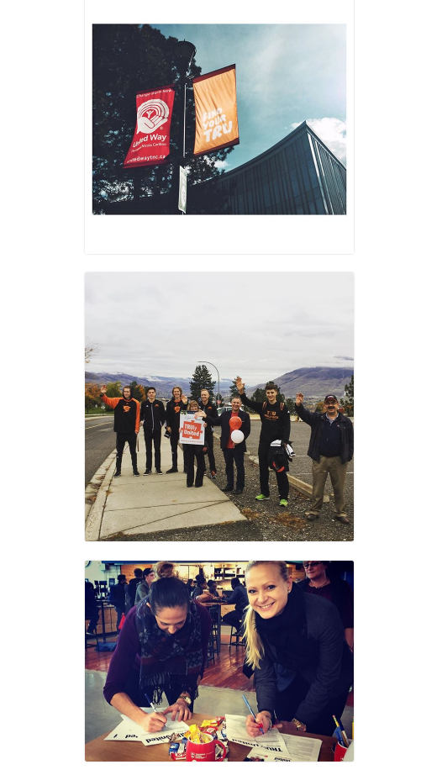
#trulyunited
Help us tell the story of this amazing community and its generosity by adding #trulyunited to your social media posts.

