Slide 1
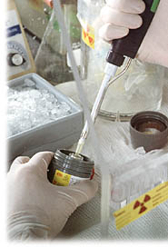
Safety in Open Source Radioisotope Laboratories
This presentation will introduce you to the theory of radioisotopes and the procedures used in their safe handling.

Slide 2
Radiation
Definition: Radiation is the energy in the form of particles or waves
Two Types of Radiation
  Ionizing: removes electrons from atoms
    Particulate (alphas and betas)
    Waves (gamma and X-rays)
  Non-ionizing (electromagnetic): can't remove electrons from atoms
    infrared, visible, microwaves, radar, radio waves, lasers

Slide 3
Nomenclature for Elements
"X" = Element Symbol
"Z" = # Protons
  Each element has a unique "Z”
"N” = # Neutrons
Atomic Mass # = "A“
"A" = Z + N = # Protons + # Neutrons
Isotope: same Z, different N, thus different A
Radioisotope: An unstable isotope

Slide 4
Phosphorous
15 Protons
P-31
    16 Neutrons and stable
P-32
    17 Neutrons and unstable
31
P
15
32
P
15

Slide 5
Decay Law & Half-Life
Half life: The time required to reduce the amount of a particular type of radioactive material by one-half
Example: 120 Ci of P-32 (t _{1/2} = 14 days)
140
120
100
−λt
A_{(t)} = A₍₀₎ * e
80
Activity (curies)
60
A_{(o)} = Initial Activity
A_{(t)} = Activity after time "t"
t = Decay time
λ = constant = 0.693 / t_{1/2}
t _{1/2} = half-life
40
20
0
0
14
28
42
56
70
84
98
Time (days)

Slide 6
Gamma Radiation
Wave type of radiation - non- particulate
Photons that originate from the nucleus of unstable atoms
No mass and no charge
Travel many feet in air
Lead or steel used as shielding
Eg: I- 131

Slide 7
Beta Particles
  Low mass (0.0005 amu)
  Low charge - can be positively or negatively charged (+/- 1)
  Travel 10 - 20 feet in air
  Stopped by a book
  Shield betas with low density materials such as lucite or plexiglass
  Shielding high energy betas like P-32 with lead can generate more radiation than it shields due to Bremsstrahlung X-rays

Slide 8
Bremsstrahlung Radiation
Energy is lost by the incoming charged
particle through a radiative mechanism
Beta Particle
Bremsstrahlung Photon
-
+
+
Nucleus

Slide 9
Alpha Particles
Alpha particles
  High mass (4 amu) = 2 protons + 2 neutrons – eg Ra-226
  High charge (+2)
  High linear energy transfer (cause great biological damage)
  Travel a few centimeters in air
  Stopped by a sheet of paper or protective layer of skin
  Not an external hazard
  Concern would be for ingestion or inhalation

Slide 10
Examples of Nuclear Decay
Beta Minus Decay:
(neutron-excess nuclides)
32
P
β
-
32
+
S
15
0
16
14
C
β
-
14
+
7
N
6
0
Beta Plus Decay:
(neutron-deficient nuclides)
22
Na
β
+
22
Ne
11
0
10
Alpha Decay:
(Heavy nuclides above
atomic number 82)
210
206
4
Po
Pb
+
α
84
82
2

Slide 11
Specific Radioactive Materials
Phosporous-32
  14.3 day half life
  High energy beta (1.710 MeV max)
  Shield with low Z material such as plastics
  Do not use lead shielding
  Wear safety glasses to shield eyes
  Ring badges are required for handling millicurie quantities
  GM survey meter required
  Avoid handling containers for extended periods

Slide 12
Specific Radioactive Materials
Tritium (Hydrogen-3)
  12.3 year half life
  Very low energy beta (0.0186 MeV max)
  No shielding needed
  Surveys by wipe method counted on LSC
Carbon-14
  5730 year half life
  Low energy beta (0.156 MeV max)
  Shielding not needed
  Spot checks with GM are possible but contamination surveys using wipes are necessary

Slide 13
Units of Measure
  Disintegrations per minute (dpm)
  Counts per minute (cpm)
  Disintegrations per second (dps)
  The SI unit for activity is the becquerel (Bq)
  1 Bq = 1 disintegration/second
  1 Curie (Ci) = 3.7¹⁰ Bq or 37 GBq
    1 millicurie = 37 MBq
    1 microcurie = 37 kBq

Slide 14
Units of Relative Biological Effectiveness (RBE)
The Sievert (SV) is the SI unit that takes into account the biological effects of the particular radiation emission based on the collision stopping power of the incident particle and is a measure of the potential biological injury of a particular type of radiation.
1 mSv= 100 mrems

Slide 15
Sources of Ionizing Radiation (World)
Radiation Source | Annual Effective Dose
 | mSv | % of total
Natural
Cosmic | 0.30 | 8
γ Rays from the Earth | 0.35 | 10
Internal Sources | 0.35 | 10
Radon | 1.00 | 29
Man-Made
Medical | 1.50 | 42
Weapons Testing | < 0.01 | < 0.03
Nuclear Power | < 0.01 | < 0.03
Total | 3.50 | 100

Slide 16
ALARA
The goal of radiation protection is to keep radiation doses As Low As Reasonably Achievable
TRU is committed to keeping radiation exposures to all personnel ALARA (zero)
What is reasonable?
  Includes: -State and cost of technology
  -Cost vs. benefit
  -Societal & socioeconomic considerations

Slide 17
Maternal Factors & Pregnancy
Statistically, a radiation exposure of 1 rem (0.01 mSV) poses much lower risks for a woman than smoking tobacco or drinking alcohol during pregnancy
Smoking
General
Babies weigh 5-9 oz. Less than average
< 1 pack/day
Infant Death
1 in 5
> 1 pack/day
Infant Death
1 in 3
Alcohol
2 drinks/day
Babies weigh 2-6 oz. Less than average
1 in 10
2-4 drinks/day
Fetal alcohol syndrome
1 in 3
> 4 drinks/day
Fetal alcohol syndrome
1 in 3 to 1 in 2
Radiation
1 rem
Childhood leukemia deaths before 12 years
1 in 3333
1 rem
Other childhood cancer deaths
1 in 3571

Slide 18
Safety in Radioisotope Laboratories
It is important to remember and comply with these safety instructions.
Students not working according to these precautions may be asked to leave the lab.

Slide 19
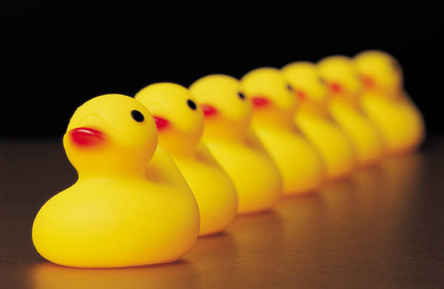
General Safety Precautions
No eating or drinking in the lab
Suitable footwear: no open toes or heels
Report all cuts, scrapes, burns or other injuries to the instructor
Keep fingers and objects away from your mouth and eyes
Notes:
19
Important to report injures so proper medical action is taken if required
Fingers pens etc near eyes may result is spread of biohazardous or chemical bench contaminants to eyes or mouth
Food is to be eaten in hallways

Slide 20
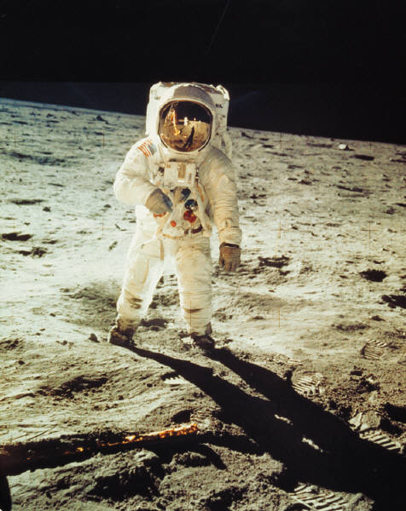
General Radiation Safety Precautions
All students must wear a lab coat and gloves in the radioisotope lab
Always be aware of your surroundings and what you are doing
Use a face shield or screening when working with ³²P

Slide 21
General Radiation Safety Precautions
Time: minimize the time that you are in contact with radioactive material to reduce exposure
Distance: keep your distance. If you double the distance the exposure rate drops by factor of 4
Shielding:
  Lead, water, or concrete for gamma & X-ray. Thick plastic (lucite) for betas
Protective clothing: protects against contamination only - keeps radioactive material off skin and clothes

Slide 22
General Safety Precautions
Disposal
  Ensure you have disposed of wastes in appropriate containers
It is important to wash hands thoroughly with a non-abrasive soap before leaving the lab or if you have spilled on your hands
Notes:
Important to dispose of properly to avoid injury or spread of disease to others who cleanup the lab

