Slide 1
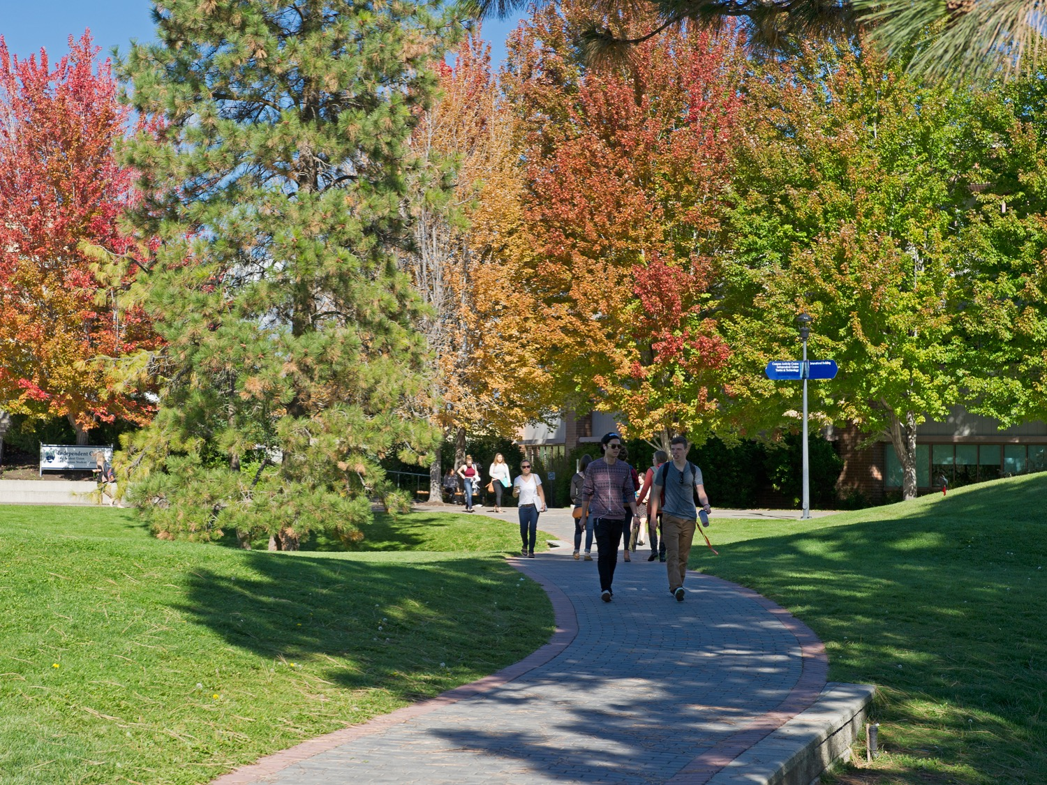
COVER PAGE:
NAME OF PRESENTATION

Slide 5
SECTION DIVIDER:
Section Name

Slide 6
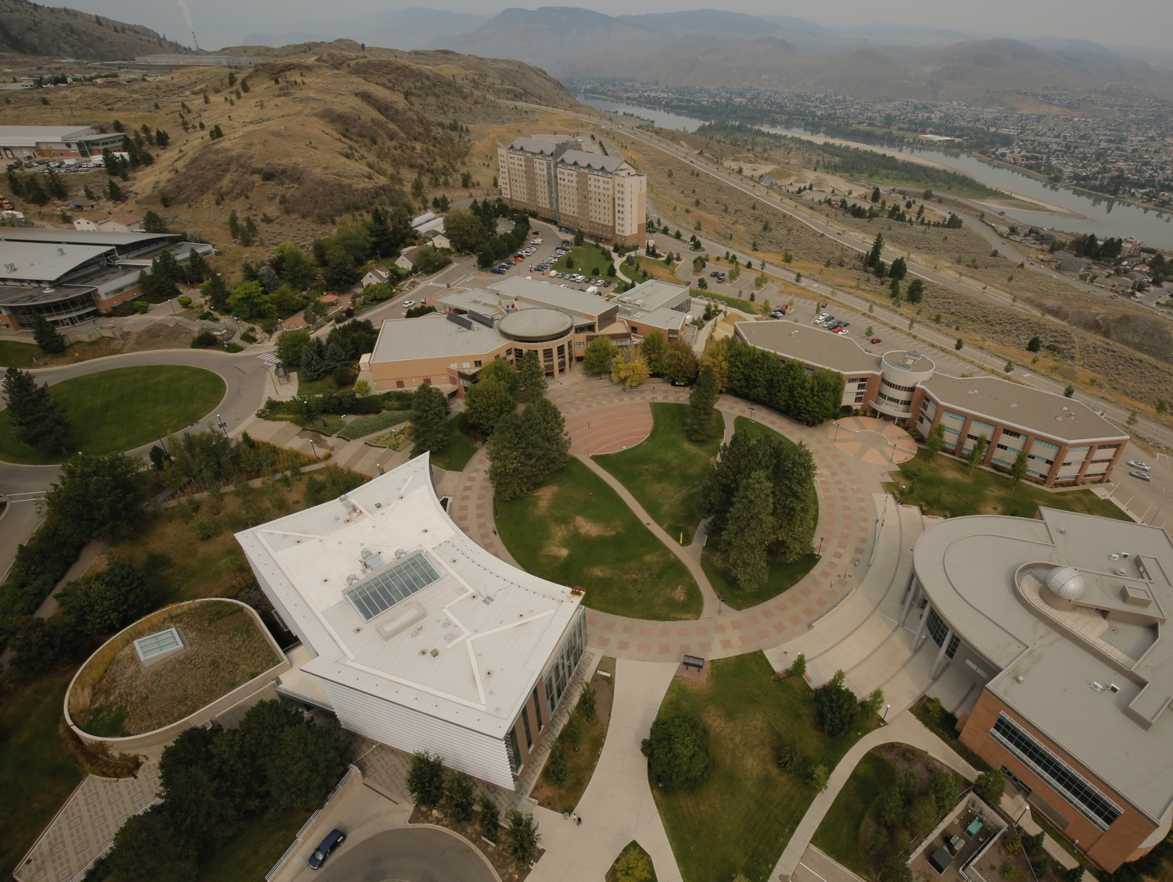
Change out this image:
HOW?
Right click on the photo and choose
Change Picture.

Slide 7
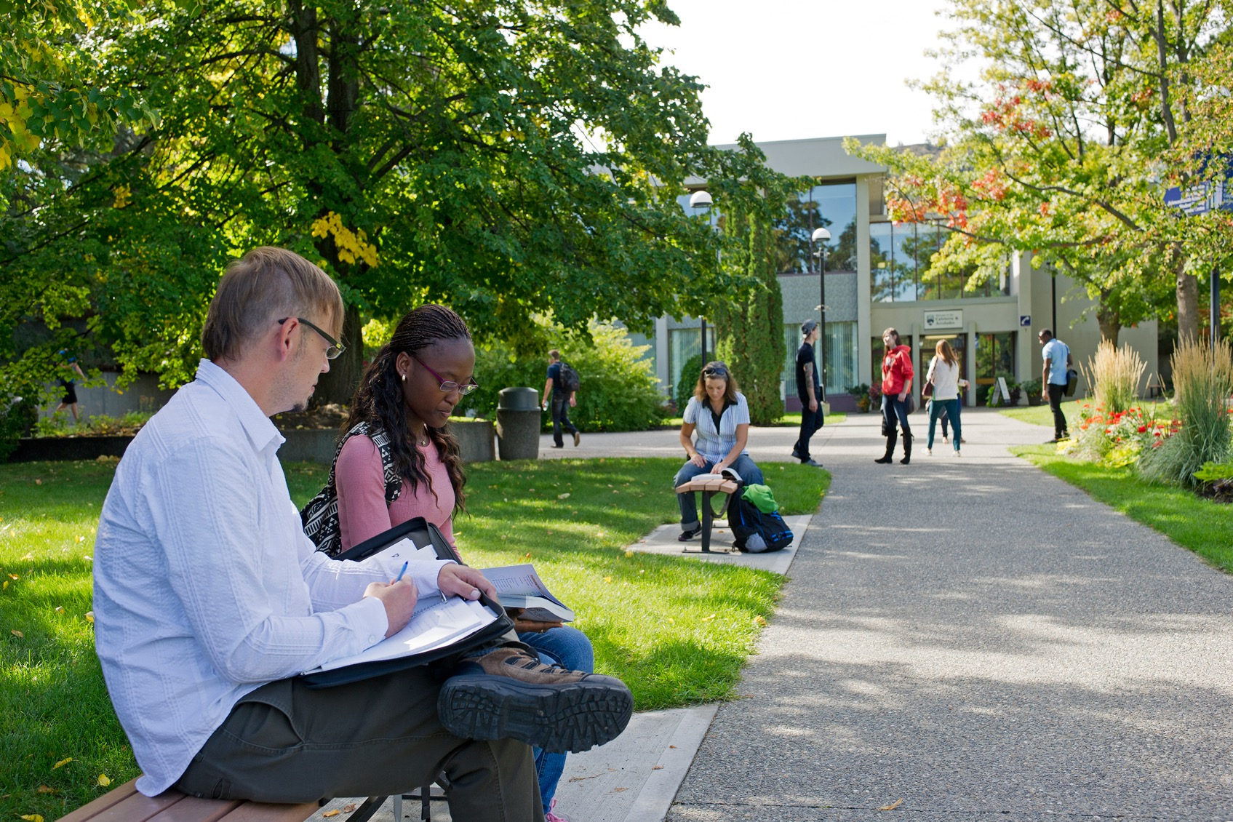
Did you know?
YOU CAN CHANGE OUT THE
BACKGROUND PHOTO.
Right click on the photo and choose
Change Picture.
Bullet point
Bullet point
Bullet point
Body text goes here and here and also here. You could also keep putting it here.

Slide 8
Did you know?
YOU CAN CHANGE OUT THE
BACKGROUND PHOTO.
Right click on the photo and choose
Change Picture.
Bullet point
Bullet point
Bullet point
Body text goes here and here and also here. You could also keep putting it here.

Slide 9
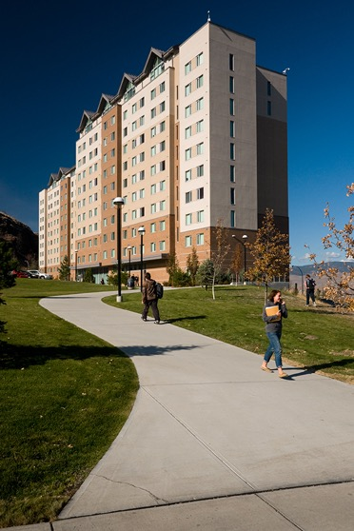
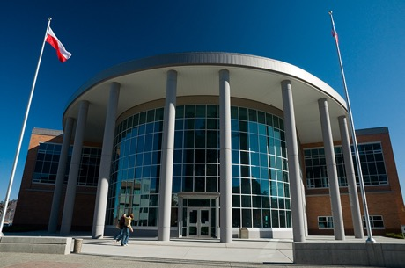
Header:
SUBHEAD TEXT
Body text goes here and here and also here. You could also keep putting it here.
Bullet point
Bullet point
Bullet point

Slide 10
Header
Body text goes here and here and here and also here.
SUBHEAD
SUBHEAD
SUBHEAD
Text goes here and here and here.
Bullet point
Bullet point
Bullet point
Text goes here and here and here.
Bullet point
Bullet point
Bullet point
Text goes here and here and here.
Bullet point
Bullet point
Bullet point

Slide 11
Header
Body text goes here and here and here and also here.
Large Bullets
Large Bullets
Large Bullets

Slide 12
Header:
SUBHEAD TEXT
At aut quis ilitatus, quis asperro inistin ullecus magnis quam unt volestenima dollupi tatur, cullatestis re lab is seque mi, comnis abo. Lori nullit quo modipsam cus adit ea deliatem.
Esequiam que nimaximil mollabo ressimus, quatur reperitat alique magnimi nihillest ex etur, et volestio eos ra sit optatem quias ut laborem utemqui officil liquasp idebis volorerum conem qui as resedit asperep tiumquat esto dipictibus.

Slide 13
Header:
SUBHEAD TEXT
At aut quis ilitatus, quis asperro inistin ullecus magnis quam unt volestenima dollupi tatur, cullatestis re lab is seque mi, comnis abo. Lori nullit quo modipsam cus adit
^{Photo Caption}

Slide 14
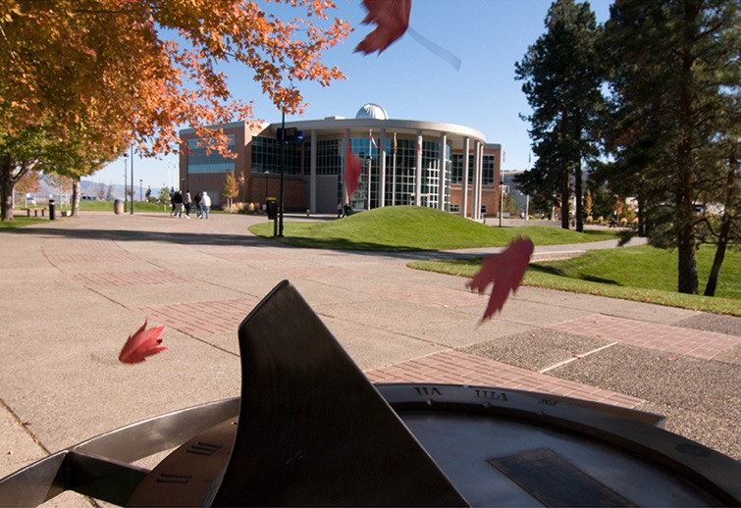
Header:
SUBHEAD TEXT
At aut quis ilitatus, quis asperro inistin ullecus magnis quam unt volestenima dollupi tatur, cullatestis re lab is seque mi, comnis abo. Lori nullit quo modipsam cus adit ea deliatem esequiam que.
^{Photo Caption}

