Slide 1
Online Learning at ISIS A user-friendly language learning system for new immigrants
Muhammad Naz
ESL Instructor
TESL Canada Presentation - October 13, 2012

Slide 2
Online Learning Community
ISIS continues to be a leader in providing a welcoming and inclusive online learning environment for immigrants.
ISIS has served pre-arrival clients living in 83 countries around the world.
There have been 721 online registered users from Sep. 2011 to Sep. 2012 (one year period).
27 % of immigrants live outside Metro Halifax.
100% of the “Writing Skills” workshop clients indicated they improved their skills.

Slide 3
Online Services Overview
Language and communication skills
Pre-landing language and pre-employment support
Business development and economic integration
Literacy teacher training
Orientation to Nova Scotia (social integration)
Nova Scotia Start (information and referral for new immigrants)
IPSO (Integrated pre-Arrival Services Online)
LINC Home study program
Language Counselling

Slide 4
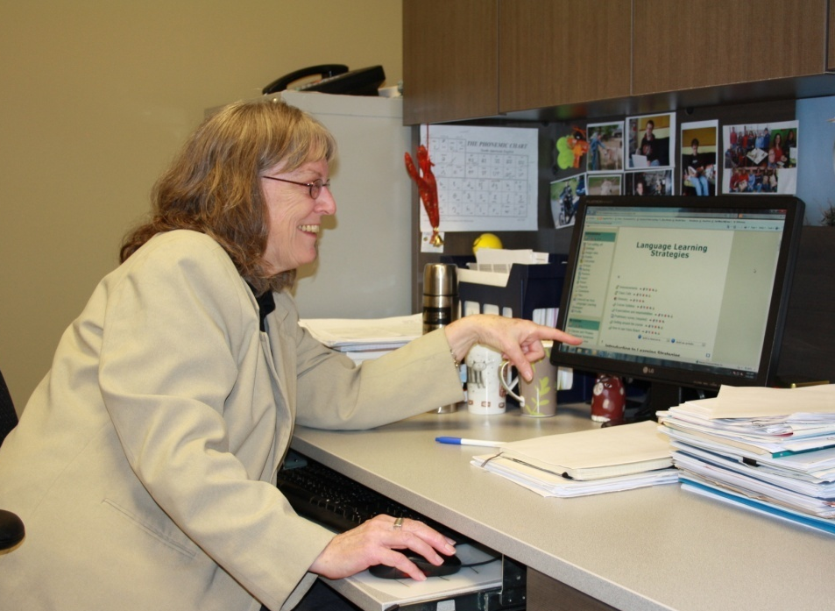
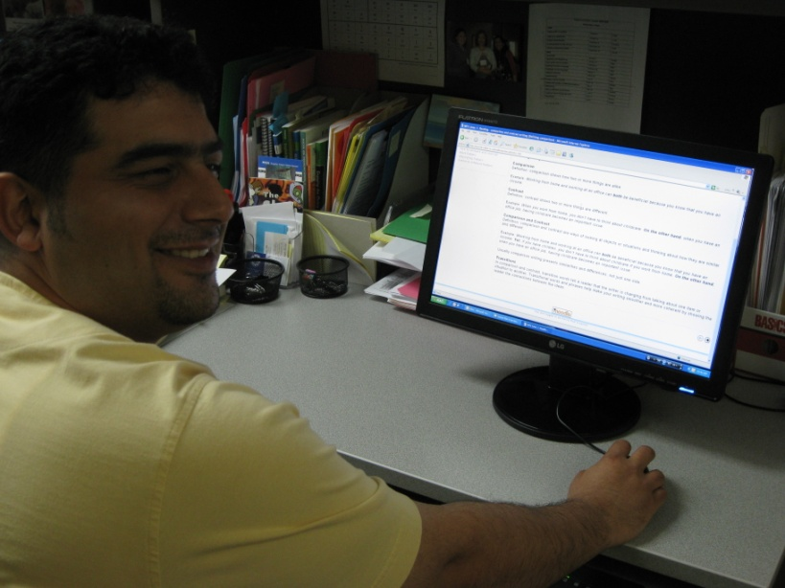
Rationale for Online Services
Pre-arrival services
On the job
Accessibility
Scheduling
Location
Preference
Facilitated courses

Slide 5
Key Considerations for Clients
For clients, an online learning system:
is easily accessible and flexible
is more personalized
is standardized
is repetitive
has chance of increased attendance and retention
has a greater chance of reflection
has a welcoming and inclusive learning environment
has a way of enhancing confidence & motivation
Notes:
– flexible to clients’ work and family schedules. No barriers such as transportation and childcare.
– clients learn and interact with content at different speeds.
regardless of their geographical location, clients benefit from the same content and process.
Establishing and maintaining a welcoming and inclusive learning environment and a social presence is vital to successful learning in the online environment at ISIS.
– clients have the flexibility to read and re-read course material, watch, pause and re-watch course related videos, and listen, pause and repeat audio files.
– the combination of culturally appropriate multimedia and course content creates a rich and engaging learning experience.
–Online learning enables learners to reflect on content, have time to process and practice the practical application in daily life.
Clients can take their time responding to discussion threads.

Slide 6
Listening & Speaking Skills:
Clear Speaking Online
Listening at Work Online
Writing Skills:
Introduction to Writing
Writing Emails Workshop
Basic Writing Skills
Professional Writing Skills
TOEFL Writing
Other Courses:
Customer Service
Language Learning Strategies
Non-facilitated:
Grammar Online
Idioms for the Workplace
Say it Better: A Pronunciation Series
Labour Market Language Classes Online

Slide 7
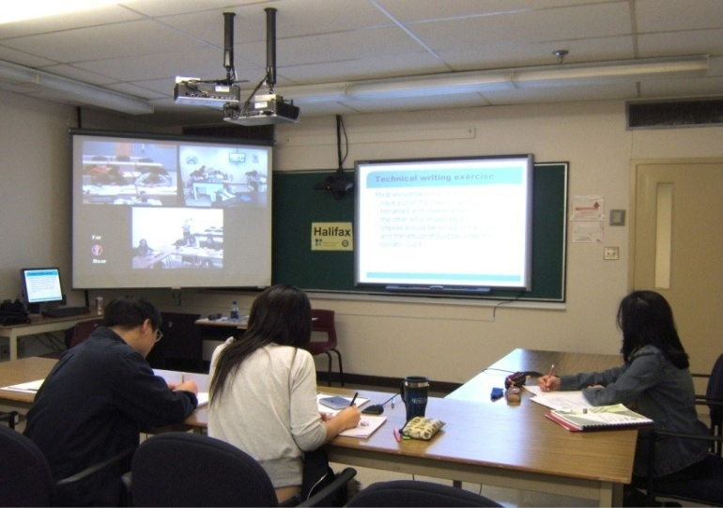
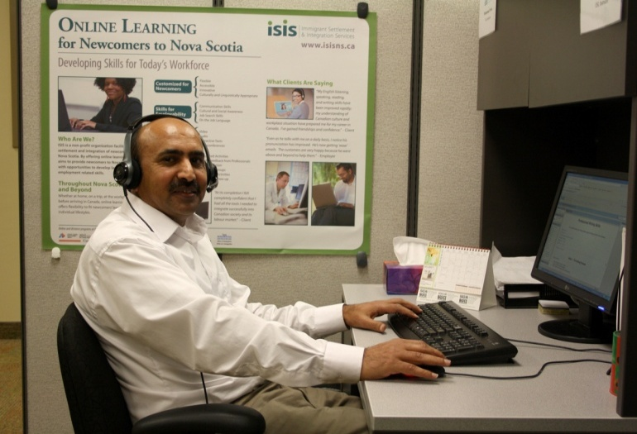
Online courses/ Demonstration
(http://onlinelearning-isisns.ca/course/index.php )
Pedagogical aspects of the
online system
Grade book interface
Online feedback tools
Learners’ monitoring and tracking tools
Discussion forums
File exchange/upload facilities
Internal email/messaging systems
Testing tools - multiple choice, matching, ordering quizzes

Slide 8
Testimonials
The course helped me improve my writing skills for a professional environment. Although I had this course online, when I was in Iran, I learned a lot. The online teaching techniques and facilitation made me confident enough to write in my workplace professionally.
Pre-arrival client
I enjoyed working online. Its flexibility perfectly suited my current lifestyle.
Stay at home client

Slide 9
Testimonials
To be honest, I wouldn't have been able to write my goal statement of a minimum of 500 words for NSCC admission if I hadn't started ISIS Basic Writing Skills course online.
My favorite part in this program is when I write paragraphs/essays. I like it because when I make mistakes I receive feedback and this helps me see my weaknesses.
Basic Writing Course (July 16, 2012)
This program has been very helpful. I learned a lot of tools for good writing. Usually, I used to make a lot of mistakes before, especially with punctuation. I didn't know even about transition words, and I already have them in my favorites after completing this course.
Basic Writing Course (August 15, 2012)

Slide 10
Testimonials
Since it was my first online course, the course worked good for me. The feedback was always very careful, detailed, and helpful. Also, I always got answers of my questions.
(August 16, 2012)
I think this course is great to help us to be aware of the basic rules of writing.
(April 16, 2011)

